Slide 1



9/30/21
Adobe Experience Cloud
Adobe Experience Manager Architect Workshop
© 2021 Adobe. All Rights Reserved
1
© 2021 Adobe. All Rights Reserved 1 Adobe Digital Learning Services
Legal and Confidentiality Information
© 2021 Adobe, Inc. All rights reserved.
Every effort was made to ensure that the information in this document was complete and accurate at the time of printing. However, information is subject to change and Adobe cannot assume responsibility for any errors or omissions. Changes or corrections to the information contained in this document may be incorporated in future issues.
This copyrighted guide along with other materials for this course may not be recorded, reproduced, duplicated, reverse engineered or adapted.
Training is intended only for those individuals who have registered and paid for it; training access URLs, user names and passwords, or access of any kind may not be shared.
This document and other materials for this course are Adobe confidential and proprietary information which must be retained in confidence by the recipient.
2
© 2021 Adobe. All Rights Reserved
2
Adobe Digital Learning Services

Slide 2

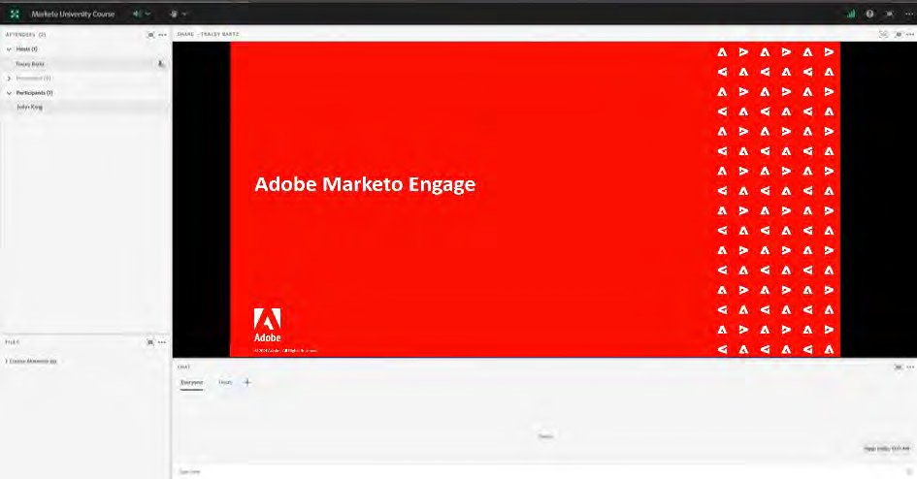



9/30/21
Adobe Connect Features
Raise your hand to confirm with instructor
Download the course materials
Start a private
chat
Chat with everyone
You will be on mute.
3
© 2021 Adobe. All Rights Reserved
3
Adobe Digital Learning Services
Student Introductions
What is your name?
What is your role?
How will you be using Experience Manager?
What version of Experience Manager are you using?
- On prem? Managed Services? Cloud Service?
What is your experience with Experience Manager, if any?
What are your expectations from this training?
5
© 2021 Adobe. All Rights Reserved
5
Adobe Digital Learning Services

Slide 3



9/30/21
vILT Points to remember Mute your phone while listening | Unmute your phone to ask a question or to make a comment | Do not place your phone on ‘hold’ as we will hear your hold music
© 2020 Adobe. All Rights Reserved. Adobe Confidential. | 6 | ADOBE DIGITAL LEARNING SERVICES
6
Course Agenda
Day 1
Module 1: Architecture
Module 2: Content and Code Migration
Module 3: Headless Delivery and SPAs
Day 2
Module 4: Adobe Experience Manager as a Cloud Service
Module 5: Adobe Experience Manager Projects and Code Deployment
Module 6: Security
Day 3
Module 7: JCR Model, Queries and Indexes
Module 8: Performance
Module 9: Solution Design
7
© 2021 Adobe. All Rights Reserved
7
Adobe Digital Learning Services

Slide 4
























9/30/21
Adobe Experience Manager Architecture
© 2021 Adobe. All Rights Reserved
8
© 2021 Adobe. All Rights Reserved 8 Adobe Digital Learning Services
Experience Manager 6+ On Premises Runtime Environment
Retrieve
Web Server
Publish
JCR
Dispatcher
Author
Invalidate
Disk Cache
Content
Publish
Replication Agent
Load Balancer
Queue
JCR
Retrieve
Web Server
Publish
JCR
Dispatcher
Invalidate
Disk Cache
9
© ⁹2021 Adobe. All Rights Reserved
9
Adobe Digital Learning Services

Slide 5



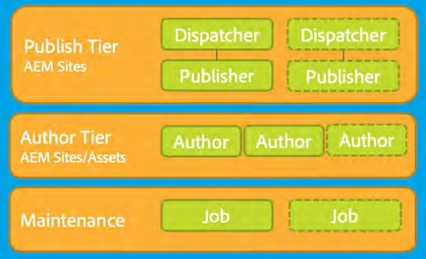

9/30/21
Experience Manager 6+ Deployed in AMS: Runtime Architecture
Adobe Managed Services Apache Web Apache Web
server/dispatcher server/dispatcher
CI/CD Service
AEM Publish
AEM Publish
AEM TarMK Author
Amazon Web Services or Azure
© 2021 Adobe. All Rights Reserved
10
Adobe Digital Learning Services
10
© 2021 Adobe. All Rights Reserved 10 Adobe Digital Learning Services
Adobe Experience Manager Cloud Service: Runtime Architecture
Per Environment
CDN Service
Shared Service
Containers
Replication Service
Content Repository Service
CI/CD Service
Identity Management Service
Assets Compute Service
Container Orchestration Service
© 2021 Adobe. All Rights Reserved
11
Adobe Digital Learning Services
11
© 2021 Adobe. All Rights Reserved 11 Adobe Digital Learning Services

Slide 6


9/30/21
Experience Manager Technical Architecture
12
Adobe Experience Manager Platform Open-source elements: OSGi Application Runtime – Apache Felix Java Content Repository (JCR) - Apache Jackrabbit Oak / CRX Web Application Framework – Apache Sling Proprietary components: Granite / Coral UI framework Workflow Engine Asset and Asset Metadata (XMP) Support Translation, Localization, and Internationalization Experience Platform support |  | AEM Application Layer Apache Sling Web Application Framework Apache Jackrabbit Oak JCR Repository / Storage Layer Apache Felix OSGi Java Container
©¹2³ 021 Adobe. All Rights Reserved | 13 | Adobe Digital Learning Services
13

Slide 7
9/30/21
Open Services Gateway interface (OSGi)
14
The OSGi Framework
OSGi:
Can replace code pieces without taking the server down
Enables building applications as a set of redo-able and strongly encapsulated services
OSGi bundles:
They are JAR files containing extra metadata
They run inside an OSGi container that manages relations among bundles
More than one version can be run in the container at the same time
Version dependencies are resolved by the container
15
©¹2⁵ 021 Adobe. All Rights Reserved
15
Adobe Digital Learning Services

Slide 8

















9/30/21
Open Services Gateway Initiative (OSGi)
Modular Application Runtime Features:
Service Registry
Semantic Versioning
Enforced Module Boundaries
Module Lifecycle Management
Inter-Module Communication (Services)
Application Code (Bundles)
Life Cycle Management
Module Management
Benefits:
Execution Environment (Java VM)
Hot Swappable Code
Clean, Versioned APIs
Service Replacement
Operating System
16
© 2021 Adobe. All Rights Reserved
16
Adobe Digital Learning Services
OSGi is a fundamental element in the technology stack of Experience Manager .
Small, reusable, and collaborative components are used
Components are composed into
bundles
Bundles are composed into an application
17

Slide 9
9/30/21
Java Content Repository
18
Defining the Java Content Repository (JCR)
JCR is a database that looks like a file system.
Supports unstructured content, and enables versioning and observation.
Provides services such as full-text search, indexing, access control, and event monitoring. JSR-283 key principles:
Common programmatic interface to content repositories
API not tied directly to the underlying architecture, data source, or protocol
Content organization in a repository model - Hierarchical modeling
Granite repository is based on Apache Jackrabbit Oak, an implementation of JSR 283
19
©¹⁹2021 Adobe. All Rights Reserved
19
Adobe Digital Learning Services

Slide 10
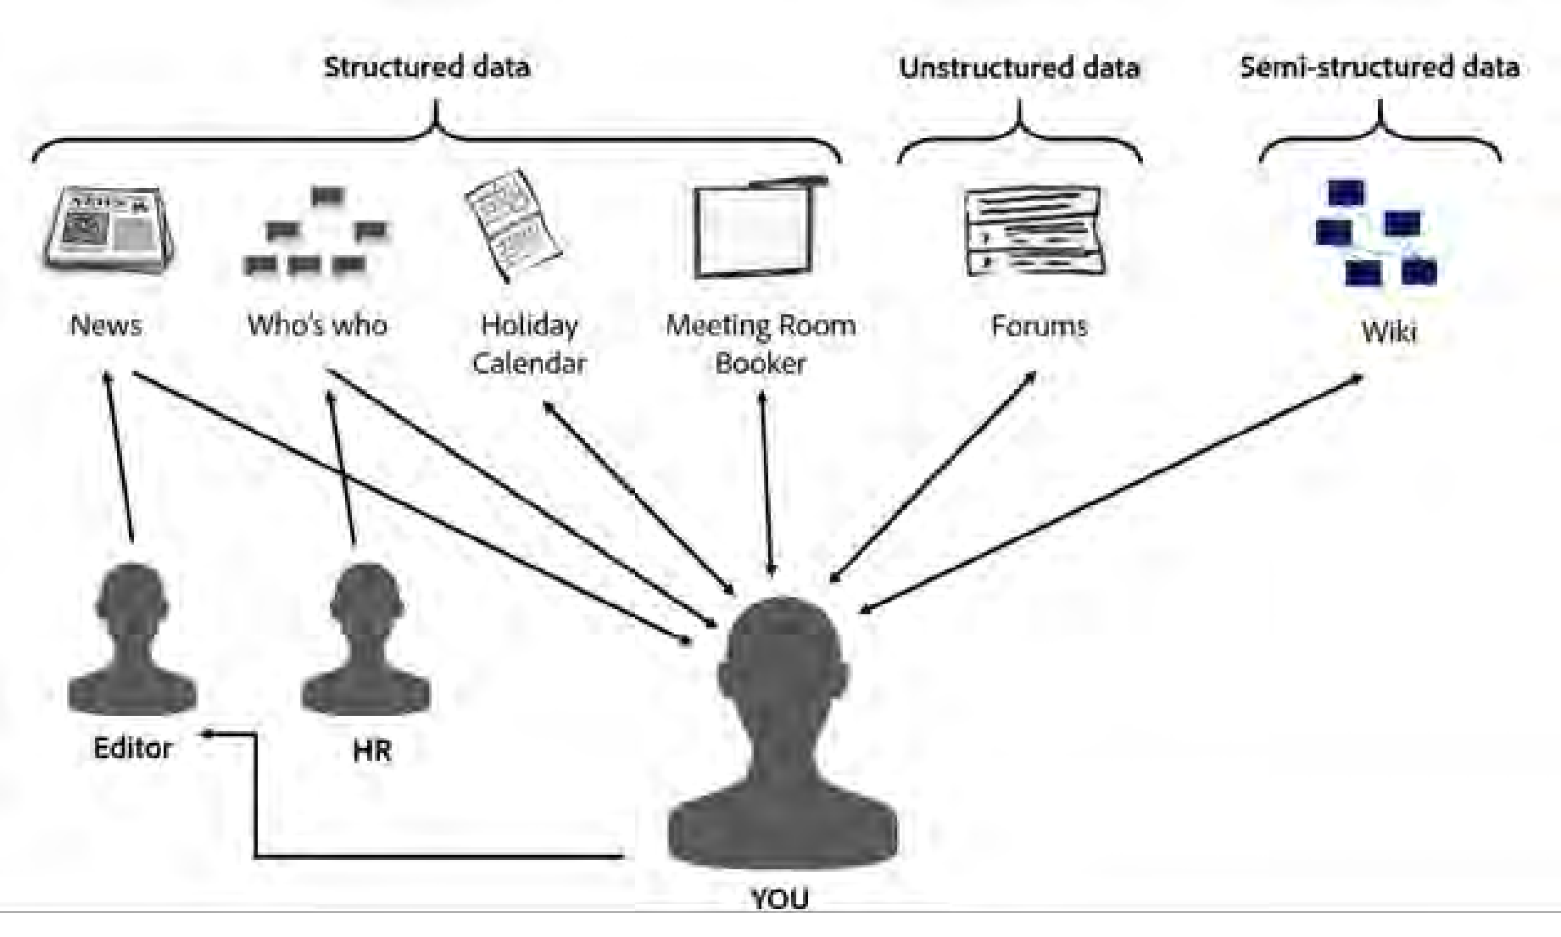








9/30/21
JCR Advantages
JCR provides a generic application data store for structured and unstructured content.
Looks like a file system… Acts like a database… Best of both worlds
20
©²2⁰ 021 Adobe. All Rights Reserved
20
Adobe Digital Learning Services
Content Repository
Transactions Query Structure Integrity
Binaries Hierarchy Locking Access Control
Standardized API
Multi-Value Properties
Unstructured
Ordering
Full Text Versioning Observation
Looks like a file system… Acts like a database… Best of both worlds
21
© 2021 Adobe. All Rights Reserved
21
Adobe Digital Learning Services

Slide 11

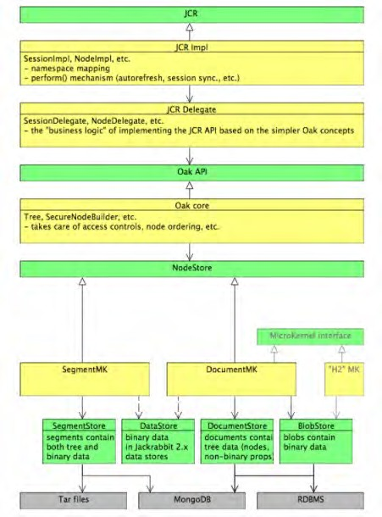
9/30/21
Oak Architecture
Alternate implementation of JSR-283 Core of the Granite repository Primary goals of Jackrabbit Oak:
Scalability
Big repositories
Distributed repository with many cluster nodes
Improved write throughput, with parallel writes
Support for more Access Control Lists (ACLs)
22
© 2021 Adobe. All Rights Reserved
22
Adobe Digital Learning Services
Understanding the Repository Structure
23

Slide 12
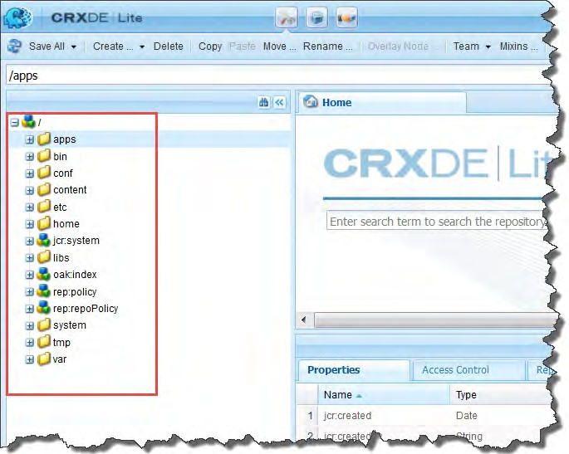

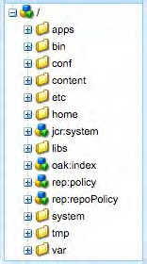
9/30/21
Understanding the Repository Structure
/apps
/libs
/conf
/content
/etc
/oak:index
/home
/tmp
/var
24
©²2⁴ 021 Adobe. All Rights Reserved
24
Adobe Digital Learning Services
Separation of Application Content and Code/Configuration
Experience Manager 6.5+ recommends
Customer
separation of content
Cloud Service architecture mandates a complete separation between
Application content
Application code and configuration
Customer application code
application content
Customer application content
AEM UI and other appliation code
25
©²2⁵ 021 Adobe. All Rights Reserved
25
Adobe Digital Learning Services

Slide 13
9/30/21
Separation of Application Content and Code/Configuration
Code and configuration
Immutable
Baked into the Adobe Experience Manager as a Cloud Service baseline image used to create the various nodes of the Author and Publish service tiers
As a result
Each node making up the service is identical
Changes to code and configuration can only be made globally by running a Cloud Manager pipeline
mutable
immutable
mutable
immutable
26
©²2⁶ 021 Adobe. All Rights Reserved
26
Adobe Digital Learning Services
Mutable vs Immutable Content
Immutable Content
/apps, /libs
Cannot be changed (create, update, delete) after Adobe Experience Manager Cloud Service starts
Mutable content
/content, /conf, /var, /home, /etc, /system, /tmp, etc.
Typical use cases for mutable content are:
Standard “default” content that is part of the customer project (e.g. folders, templates, workflows...)
Search index definitions
ACLs and permissions
Service users and user groups
27
©²2⁷ 021 Adobe. All Rights Reserved
27
Adobe Digital Learning Services

Slide 14

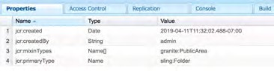

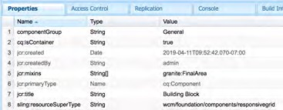

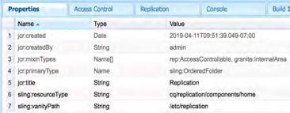
9/30/21
Repository Content Classification (/libs)
Public (granite:PublicArea mixin)
Can be
Overlaid
Inherited (sling:resourceSuperType)
Used directly (sling:resourceType)
Nodes marked as Public under /libs will be upgrade-safe
Customer apps should only leverage nodes marked as Public
28
© 2021 Adobe. All Rights Reserved
28
Adobe Digital Learning Services
Repository Content Classification (/libs) (cont)
Final (granite:FinalArea mixin)
Cannot be overlaid or inherited
Can use directly (sling:resourceType)
Children of Final nodes are considered Internal by default
Internal (granite:InternalArea mixin)
Cannot be overlaid, inherited, or used directly
Internal functionality of Experience Manager
29
©²2⁹ 021 Adobe. All Rights Reserved
29
Adobe Digital Learning Services

Slide 15

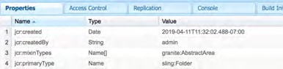

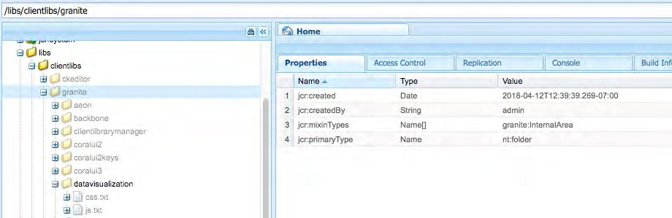
9/30/21
Repository Classification (cont.)
Abstract (granite:AbstractArea mixin)
Can be overlaid or inherited
Must not be used directly
No annotation
Inherit classification base on the tree hierarchy
Notes with parent classified as Internal or Final are treated as Internal
30
© 2021 Adobe. All Rights Reserved
30
Adobe Digital Learning Services
Repository Classification (cont.)
Granite:InternalArea Visual Cue: Grayed Out
31
© 2021 Adobe. All Rights Reserved
31
Adobe Digital Learning Services

Slide 16

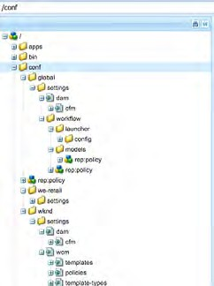

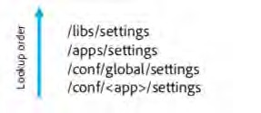
9/30/21
Apache Sling Context-Aware Configuration
Application support for different contexts and configurations for each of those contexts
Different contexts = sites, regions and tenants
Some parameters may be shared among contexts, inheritance for nested contexts and from global fallback values supported
Code should make no assumption on how context-aware configurations are searched or stored
32
© 2021 Adobe. All Rights Reserved
32
Adobe Digital Learning Services
Context-Aware Configuration
Content in one part of the repository can be overlaid multiple times by content in other parts of the repository
For example:
Content in /libs/settings can be overlayed by content in /apps/settings
Content in /apps/settings can then be overlayed by content in /conf
Content in a global folder under /conf can be overlaid by a specific "tenant”, "site”, or “app” (for example, /conf/we-retail/settings)
33
© 2021 Adobe. All Rights Reserved
33
Adobe Digital Learning Services

Slide 17
9/30/21
Apache Sling
34
The REST Architecture
REST is a software architecture style for distributed hypermedia systems such as the World Wide Web Application data and state are represented as a set of addressable resources
Resources present a uniform interface
The interface allows transfers of state, for example, reading and updating of a state An example of RESTful architecture is the web
Resources have URIs
Uniform interface is HTTP
Apache Sling is RESTful
35
©³2⁵ 021 Adobe. All Rights Reserved
35
Adobe Digital Learning Services

Slide 18
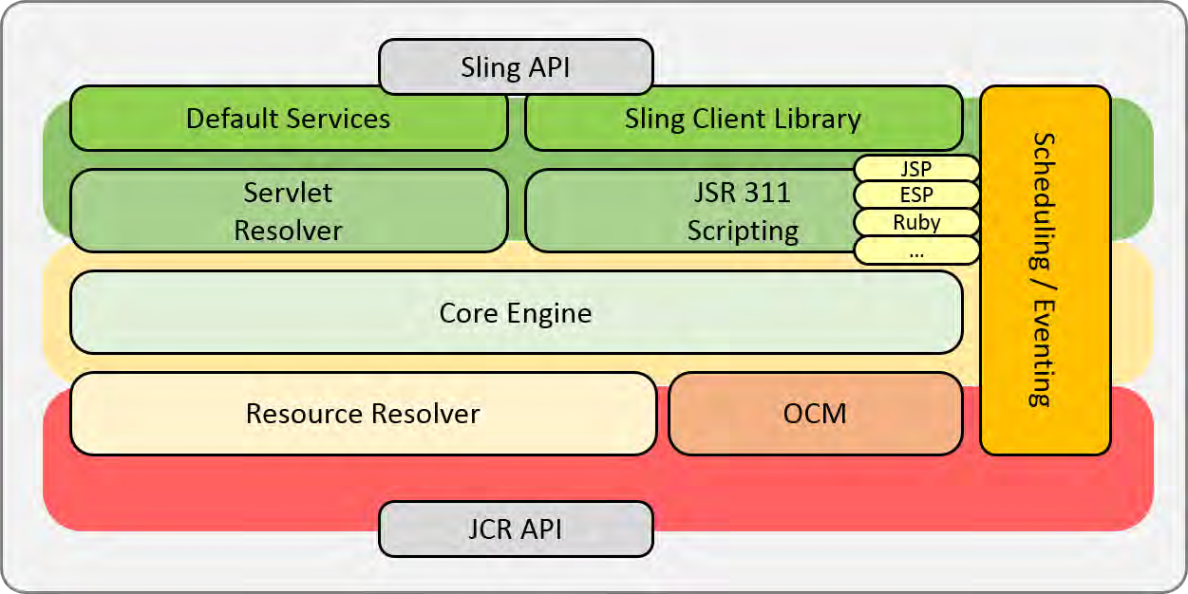
9/30/21
Introduction to Apache Sling
Key principles:
Web application framework
Content-oriented (JCR-based) application development
RESTful
Sling is resource-oriented, where every resource has a URL. Processing of a request is done by:
Checking whether the URL resolves to a content object (resource) for which a script can be found to render the content
Mapping a JCR node to the resource
36
©³2⁶ 021 Adobe. All Rights Reserved
36
Adobe Digital Learning Services
Understanding the Sling Framework
37
© 2021 Adobe. All Rights Reserved
37
Adobe Digital Learning Services

Slide 19
9/30/21
Decomposing the URL
Example:
URL: http://myhost/tools/spy.printable.a4.html/a/b?x=12
Protocol | Host | Content path | Selector(s) | Extension |  | Suffix |  | Param(s)
http:// | myhost | Tools/spy | .printable.a4 | html | / | a/b | ? | X=12
where:
Protocol: Is the Hypertext Transfer Protocol (HTTP)
Host: Is the name of the website
Content path: Is the path specifying the content to be rendered
Selector(s): Is used for alternative methods of rendering the content
Extension: Is the content format that also specifies the script to be used for rendering
Suffix: Can be used to specify additional information
Param(s): Are any parameters required for dynamic content
38
©³2⁸ 021 Adobe. All Rights Reserved
38
Adobe Digital Learning Services
Rendering Scripts
Order of script preference:
selector.ext.html
selector.html
ext.html
default-script.html (name of component)
method.html
39
©³2⁹ 021 Adobe. All Rights Reserved
39
Adobe Digital Learning Services

Slide 20

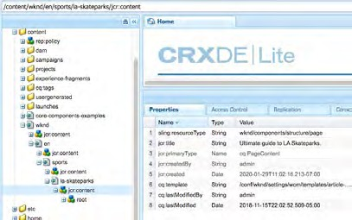



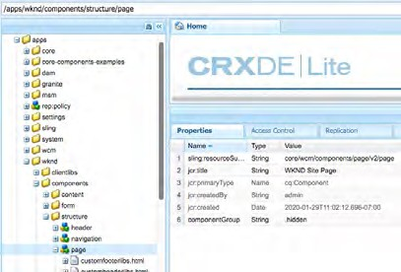
9/30/21
Understanding Sling
1
2
3
40
© 2021 Adobe. All Rights Reserved
40
Adobe Digital Learning Services
Application Services
41

Slide 21









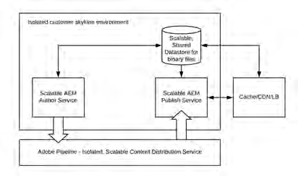
9/30/21
AEM 6+ Replication Overview
Serialized background transfer of data between AEM instances
Tight integration between replication agent and target publish instance Based on Sling jobs
Multiple agents run independently
Tight integration into authoring UI (replication status)
Author
Publish
JCR
Content
Publish
Replication Agent
JCR
Queue
Publish
JCR
42
© 2021 Adobe. All Rights Reserved
42
Adobe Digital Learning Services
AEM as a Cloud Service Content Distribution
Sling Content Distribution is used to move the content to a pipeline service run on Adobe I/O that is outside of the Experience Manager runtime:
Automated
Auto-configures itself during runtime when when publish nodes are added or removed
Publication/Unpublication, to all publish instances, is atomic
₄₃ © 2021 Adobe. All Rights Reserved
43
Adobe Digital Learning Services
43

Slide 22

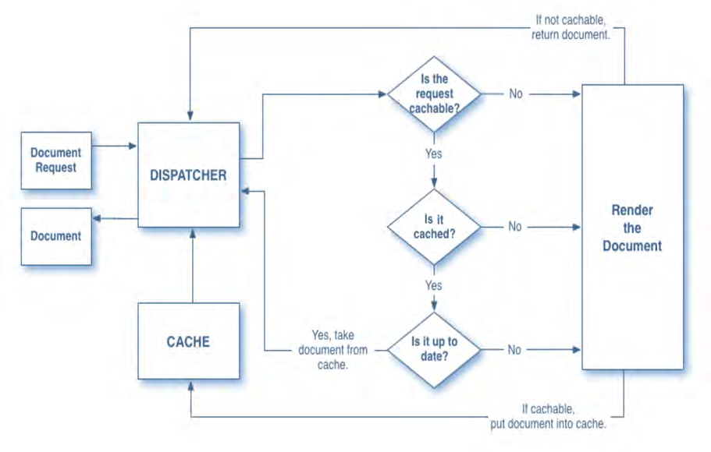

9/30/21
Webserver/Dispatcher
Traffic goes through an apache web server, which supports modules including the dispatcher
Dispatcher
Used primarily as a cache to limit processing on the publish nodes in order to increase performance
Also provides a security layer
44
© 2021 Adobe. All Rights Reserved
44
Adobe Digital Learning Services
Dispatcher Caching Algorithm
PUBLISH
45
© 2021 Adobe. All Rights Reserved
4455
Adobe Digital Learning Services

Slide 23
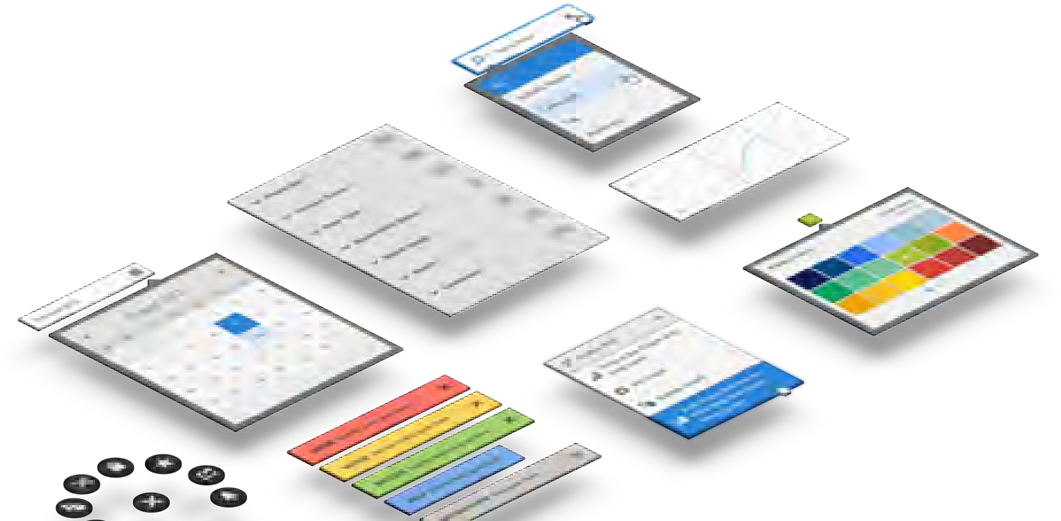
9/30/21
Coral / Granite UI
Coral UI
A touch-first, front-end framework for Adobe Cloud experiences
A set of CSS and JS components designed and built for Adobe Cloud products
Made up of component modules that can be consumed individually, allowing you to take just what you need
46
©⁴2⁶ 021 Adobe. All Rights Reserved
46
Adobe Digital Learning Services
Coral / Granite UI (cont)
Granite UI
An umbrella name for UI projects to build a LEGO® architecture for UI, so that one can build complex webapps with much less code.
Lego Architecture
Modular, composable, layerable, reusable components
Independent evolution of components
Uniform way of doing things
47
©⁴2⁷ 021 Adobe. All Rights Reserved
47
Adobe Digital Learning Services

Slide 24
9/30/21
Key Takeaways
Adobe Experience Manager Cloud Service Architecture now enforces a complete separation of application content from application code and configuration
Code and configuration is practically immutable and baked into the baseline image used to create the author and publish services
Changes to code and configuration can only be made by running Cloud Manager pipeline Publishing operations
Experience Manager 6.5+ replication agents configured to replicate to a single publish instance
Adobe Experience Manager as a Cloud Service now follows a subscription pattern implemented by the Adobe Pipeline and Sling Content Distribution
48
© 2021 Adobe. All Rights Reserved
48
Adobe Digital Learning Services
Resources
Architecture Documentation
https://experienceleague.adobe.com/docs/experience-manager-learn/cloud-service/underlying- technology/introduction-architecture.html?lang=en#underlying-technology
https://docs.adobe.com/content/help/en/experience-manager-cloud-service/core- concepts/architecture.html
https://docs.adobe.com/content/help/en/experience-manager-cloud- service/implementing/home.html
https://docs.adobe.com/content/help/en/experience-manager-cloud- service/operations/home.html
49
© 2021 Adobe. All Rights Reserved
49
Adobe Digital Learning Services

Slide 25

9/30/21
Content Migration
5©0 2021 Adobe. All Rights Reserved
50
© 2021 Adobe. All Rights Reserved 50 Adobe Digital Learning Services
Migration to Experience Manager - Understanding Data Migration
Data migration is migration from legacy systems to the new system, in this case, AEM
Involves a detailed study of the architecture of the old system and the new system Legacy systems:
Could be single or disparate
Could have their own Content Management Systems (CMS)
51
©⁵2¹ 021 Adobe. All Rights Reserved
51
Adobe Digital Learning Services

Slide 26

9/30/21
The Migration Process The Process: Identify the source. Transform the source to target format. Import into repository. Two approaches to migration: One-time migration Continuous migration Types of migration: Automated migration Partially automated migration Manual migration Migration on request |  | THE MIGRATION PROCESS Identify Transform Import
©⁵2² 021 Adobe. All Rights Reserved | 52 | Adobe Digital Learning Services
52
Migrating Data From Legacy Systems
Pre-Migration tasks:
Scrub your data
Obsolete product pages/data
General Clutter
Old Press Releases
Ob pa
solete test ges/data
Out
da
ted
Marketing
Campaign
Landing Pages
53
©⁵2³ 021 Adobe. All Rights Reserved
53
Adobe Digital Learning Services

Slide 27





9/30/21
Migrating Data From Legacy Systems (cont)
Pre-Migration tasks (cont):
Plan your migration:
Analyze the source system
Define the source data architecture and all the special considerations for the migration
Understand the source system’s ability to export data
Define pre-format data considerations
Data Format
54
©⁵2⁴ 021 Adobe. All Rights Reserved
54
Adobe Digital Learning Services
Migrating Data From Legacy Systems (cont)
Pre-Migration Tasks (cont):
Implementation considerations:
Define the data manipulation/transformation that needs to take place.
Consider breaking the migration process into sub-migrations.
Define the node/property structure for the new system.
Perform a test on dummy data before testing on real data. Migrate
Tools: VLT, POST servlet, JCR/SLIN/WCM APIs
55
©⁵2⁵ 021 Adobe. All Rights Reserved
55
Adobe Digital Learning Services

Slide 28











9/30/21
Identifying Cost Benefit
Based on the complexity and size of the migrating system, use any of the following three methods for migration:
Manual migration (human data entry)
Automated migration (using APIs)
Hybrid migration (combination of manual and automated)
56
©⁵2⁶ 021 Adobe. All Rights Reserved
56
Adobe Digital Learning Services
Sample Project Timelines Base templates done Technical Migration Dev Stage/UAT ^{Power User Training} Author Template Training Content Migration | Prod | Feature complete Go Live Test Go Live Go Live
© 2021 Adobe. All Rights Reserved 57 |  | Adobe Digital Learning Services
57

Slide 29

9/30/21
What affects the migration timeline?
Business requirements
Constraints, success criteria, content to be migrated from legacy system Implementation considerations
Data architecture, migration tool(s), migration approach, source, target, data manipulation,
Proof of concept?
Legacy data considerations (source)
Source data architecture, pre-formatting/manipulation of source data
Target considerations (CRX content structure)
Target content structure, Adobe best practices, performance
58
© 2021 Adobe. All Rights Reserved
58
Adobe Digital Learning Services
What affects the migration timeline? (cont)
Execution considerations
Time of execution, development team constraints, contingency plans, recovery process, team information flow
Quality assurance considerations
Success criteria, QA requirements, QA process (automated/manual/hybrid)
Project success measurement considerations
59
© 2021 Adobe. All Rights Reserved
59
Adobe Digital Learning Services

Slide 30
9/30/21
Content Migration Group Exercise
We will be looking at 3 case studies. You have 1 hour to work on your assigned case study, then we will discuss them as a group. Please feel free to ask any questions you might have. Document your assumptions!! The accuracy of your solution will depend on the assumptions that you make. |  | For each case study you should define the following Migration approach: Automated/Manual/Hybrid Content Structure of the target: General content model – /content structure, Node types, properties Other considerations: Planning POC? QA Timeline
© 2021 Adobe. All Rights Reserved | 60 | Adobe Digital Learning Services
60
Key Takeaways
Content Migration Process:
Identify the source.
Transform the source to target format.
Import into repository
Identify items that can affect the project timeline Identify cost/benefit of migration method
Tools exist to help modernize website
Change from static to editable templates
Change from foundation components to proxy components
61
© 2021 Adobe. All Rights Reserved
61
Adobe Digital Learning Services

Slide 31
9/30/21
Resources
AEM Code Modernization Tools
https://opensource.adobe.com/aem-modernize-tools/pages/tools.html
https://experienceleague.adobe.com/docs/experience-manager-cloud- service/moving/refactoring-tools/asset-workflow-migration-tool.html?lang=en#refactoring-tools
AEM Cloud Transition Tools
https://experienceleague.adobe.com/docs/experience-manager-cloud-service/moving/cloud- migration/cloud-readiness-analyzer/overview-cloud-readiness-analyzer.html?lang=en#cloud- migration
62
©⁶2² 021 Adobe. All Rights Reserved
62
Adobe Digital Learning Services
Headless Content Management
63

Slide 32

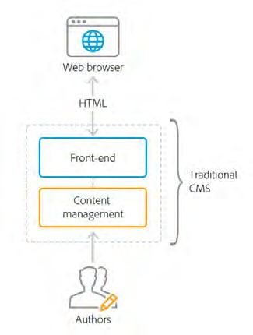

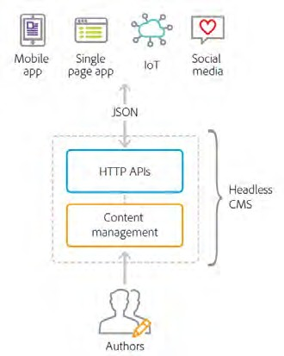
9/30/21
Traditional CMS Architecture
Manages and delivers content on a single technology stack
Minimizes total cost of ownership with efficient system maintenance and training
Controls all templating and presentation logic Outputs fully formatted HTML
Often tightly coupled with a single channel
Results in a monolithic software architecture
Can make multichannel content delivery difficult and costly.
64
© 2021 Adobe. All Rights Reserved
64
Adobe Digital Learning Services
Headless CMS Architecture
Does not deliver HTML or formatted content directly
Decouples content from presentation
Enables content to be used by a variety of front- end technologies.
Exposes content through well-defined HTTP APIs
Note: The term ‘headless’ originates from the idea that the front-end presentation layer is the “head” of the application
65
© 2021 Adobe. All Rights Reserved
65
Adobe Digital Learning Services

Slide 33

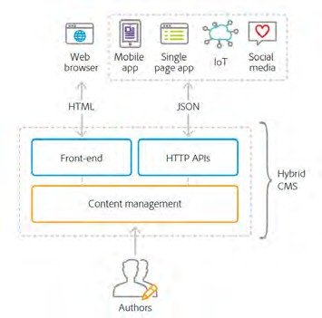


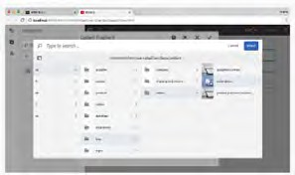
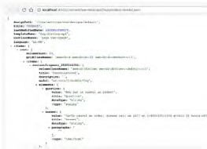
9/30/21
Hybrid CMS Architecture
Experience Manager takes a hybrid approach
Efficiency and ease of use of a traditional CMS
Flexibility and scalability of a headless development framework
Central hub to house and distribute content and experiences to any channel
Delivers content either as fully formatted HTML or as JSON over HTTP APIs
Brands choose between traditional or headless delivery
mix and match capabilities to meet their business needs
66
© 2021 Adobe. All Rights Reserved
66
Adobe Digital Learning Services
Hybrid CMS Architecture (cont)
AEM includes features that express content in a variety of formats through API endpoints:
Content services
Exposes content via HTTP APIs using a standard JSON schema, enabling brands to expose content to any channel without coding.
Sling Model Exporter
Allows developers to quickly render any Experience Manager content into JSON using custom business logic.
67
© 2021 Adobe. All Rights Reserved
67
Adobe Digital Learning Services

Slide 34

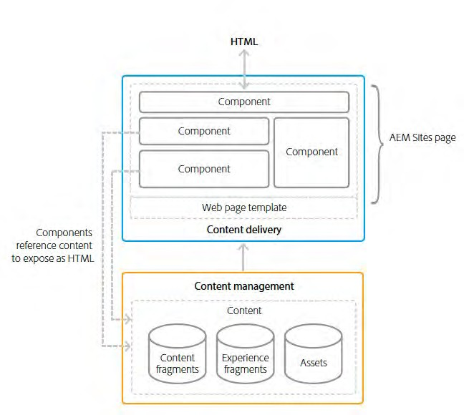

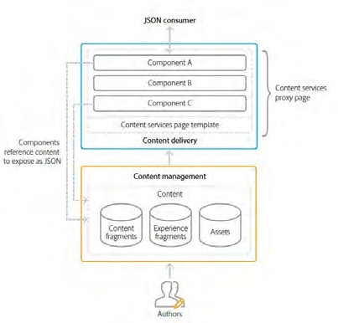
9/30/21
Multi-Channel Content Delivery and Content Services
To support all channels a CMS must expose the managed content in a multi-format and scalable way.
Standard formats for exposing web content:
HTML – language of the web browser
JSON – lightweight delivery format that powers modern connected applications
68
© 2021 Adobe. All Rights Reserved
68
Adobe Digital Learning Services
Experience Manager Delivery of HTML and JSON
AEM uses templates, pages, and components to compose content and deliver it via both HTML and JSON
Components can reference and reuse content abstraction features within the same channel or across channels :
Content fragments
Experience fragments
Assets
69
© 2021 Adobe. All Rights Reserved
69
Adobe Digital Learning Services

Slide 35

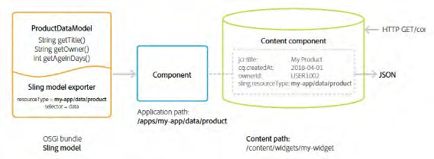
9/30/21
Sling Models
Preferred method for implementing the business logic of an Experience Manager component. Supports both, HTML components and headless Content Management System (CMS).
Java objects that can be mapped to Sling resources. Can export JSON objects
JSON objects are then used by programmatic web consumers such as other web services and JavaScript applications
70
© 2021 Adobe. All Rights Reserved
70
Adobe Digital Learning Services
AEM Sling Model Exporter
Builds on the Sling HTTP web framework Extension of Sling Models
Provides a mechanism for serializing Sling Model Java objects into any JSON format Sling Models
Developed in Java as annotated POJOs
Represent some logical set of content or data
71
© 2021 Adobe. All Rights Reserved
71
Adobe Digital Learning Services

Slide 36
9/30/21
Experience Manager Single Page Application (SPA)
72
What is a Single Page Application (SPA)?
Differs from a conventional page in that it is:
rendered client-side
primarily Javascript-driven
relies on Ajax calls to load data and dynamically update the page Content is retrieved once in a single page load
additional resources loaded asynchronously as needed based on user interaction
Reduces the need for page refreshes and feels like a native app experience
73
© 2021 Adobe. All Rights Reserved
73
Adobe Digital Learning Services

Slide 37


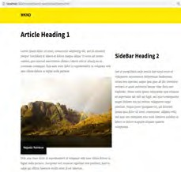
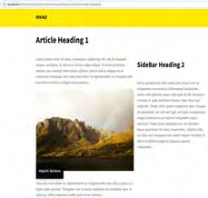
9/30/21
Enabling SPA with Experience Manager Site SPA Editor
Developers can build SPA experiences rapidly with popular JavaScript frameworks such as React and Angular
Typically using decoupled or “headless” CMS AEM Sites
Enables developers by integrating with familiar frameworks and development tools
SPA Editor offers a WYSIWYG user interface that enables marketers and authors to make in- context changes to content, layout, and presentation, just as they would with traditional web pages
74
© 2021 Adobe. All Rights Reserved
74
Adobe Digital Learning Services
Experience Manager and SPA
Developers build sites using SPA frameworks
Authors seamlessly edit content within AEM for a site built using such frameworks
AEM instance and React/Angular Development Server render the same content
75
© 2021 Adobe. All Rights Reserved
75
Adobe Digital Learning Services

Slide 38
9/30/21
SPA Development Principles for AEM
Portability
Components should be built to be as portable as possible. The SPA should be built with portable and reusable components.
Experience Manager drives Site structure
Front-end developer creates components and owns their internal structure, but relies on AEM to define the content structure of the site
Dynamic Rendering
All rendering should be dynamic. Dynamic Routing
SPA is responsible for the routing and Experience Manager fetches based on that routing. Routing should be dynamic as well.
76
©⁷2⁶ 021 Adobe. All Rights Reserved
76
Adobe Digital Learning Services
AEM SPA Editor
Allows front-end developers to create SPAs
Using common front-end languages
That can be integrated into an Experience Manager site
Allows content authors to edit the SPA content as easily as any other Experience Manager content
Leverages Experience Manager Content Services to deliver the entire content of the page as a JSON model
77
© 2021 Adobe. All Rights Reserved
77
Adobe Digital Learning Services

Slide 39

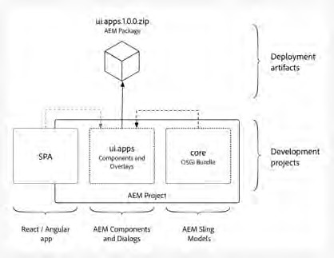

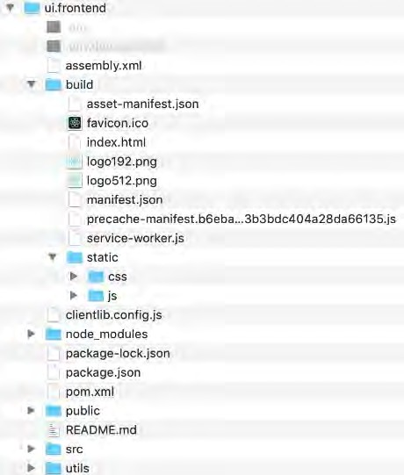
9/30/21
Implementation/Deployment Integration Approach
Development done in Webpack project
Compiled SPA copied into ui.apps as a client-side library
Deployed to Experience Manager as a content package
78
© 2021 Adobe. All Rights Reserved
78
Adobe Digital Learning Services
9
React build
Files created by
npm run build
.js and .css files will be copied into an AEM clientlib by npm build process
Defines how Client Library will be generated
Defines dependencies & version. Defines scripts to run during build.
React component
.js and .sass files
79
© 2021 Adobe. All Rights Reserved
79
Adobe Digital Learning Services

Slide 40

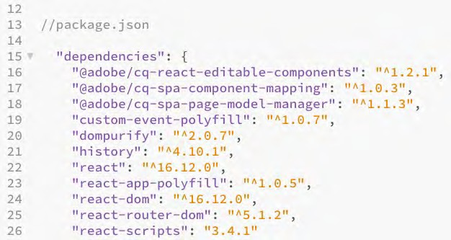
9/30/21
Experience Manager SPA Editor JS SDK dependencies
npm modules provided by Adobe
These 3 modules make up
the AEM SPA Editor JS SDK
80
© 2021 Adobe. All Rights Reserved
80
Adobe Digital Learning Services
AEM SPA Editor JS SDK
Collection of JS libraries
Framework for editing contents of a SPA deployed in Experience Manager
Experience Manager delivers content as JSON and SPA Editor JS SDK maps the JSON to React components
Available via three npm modules:
@adobe/cq-spa-component-mapping - provides helpers to map AEM Components to SPA components. This module is not tied to a specific SPA framework.
@adobe/cq-spa-page-model-manager - provides the API to manage the model representation of the Experience Manager Pages that are used to compose a SPA. This module is not tied to a specific SPA framework.
@adobe/cq-react-editable-components - provides generic React helpers and components to support authoring. This module also wraps the cq-spa-page-model-manager and cq-spa- component-mapping to make these available to the React framework.
81
© 2021 Adobe. All Rights Reserved
81
Adobe Digital Learning Services

Slide 41

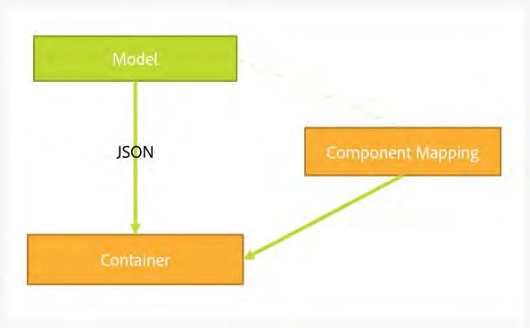

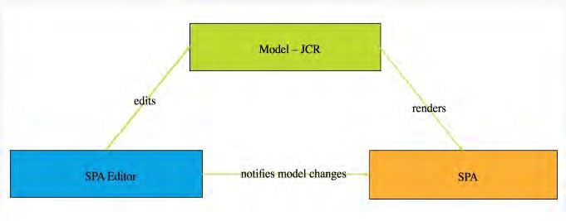
9/30/21
2
Page Model Management (cont)
For each resource in the exported model the SPA maps an actual component which will do the rendering
The model, represented as JSON, is then rendered using the component mappings within a container
82
© 2021 Adobe. All Rights Reserved
82
Adobe Digital Learning Services
Communication Data Type
cq.authoring.pagemodel.messaging client library sends a message to the Page Editor to establish the JSON communication data type
When the communication data type is set to JSON, GET requests will communicate with the Sling Model end-points of a component.
After an update occurs in the page editor, a JSON representation of the updated component is sent to the Page Model library
Page Model library then informs the SPA of updates.
83
© 2021 Adobe. All Rights Reserved
83
Adobe Digital Learning Services

Slide 42

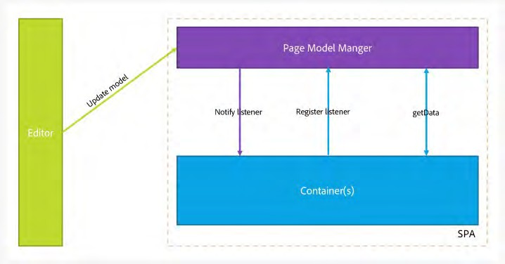

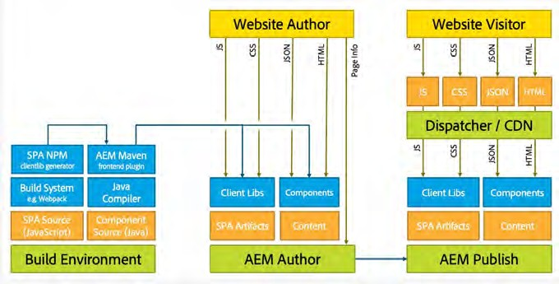
9/30/21
Flow of Interaction Between SPA and Experience Manager
SPA Editor is mediator
Communication between Page Editor and SPA is JSON, not HTML
Page Editor provides latest version of the page model to the SPA via iframe and messaging API
Page Model Manager notifies editor that it is ready and passes page model as a JSON structure
Editor does not alter or access the DOM structure of the page being authored, rather it provides latest page model.
84
© 2021 Adobe. All Rights Reserved
84
Adobe Digital Learning Services
5
AEM Architecture and SPAs
85
© 2021 Adobe. All Rights Reserved
85
Adobe Digital Learning Services

Slide 43
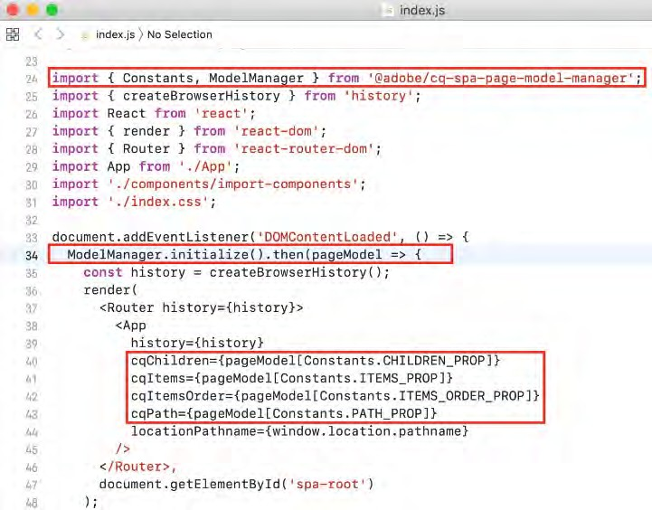
9/30/21
Heart of the React App
Index.js is the React app entry point and initiates connection to app CSS and the DOM
Initializes connection to Experience Manager json data for the app
ModelManager is provided by the Experience Manager SPA Editor JS SDK. It is responsible for calling and injecting the pageModel (the JSON content) into the application
App.js handles the view generation and component inclusion:
Main app JavaScript component
Container for all other components
Extends React’s Page class to define a page component
86
© 2021 Adobe. All Rights Reserved
86
Adobe Digital Learning Services
7
Integrate Experience Manager SPA Editor JS SDK – react-app/src/index.js
Initialize the App with AEM JSON Model
87
© 2021 Adobe. All Rights Reserved
87
Adobe Digital Learning Services

Slide 44
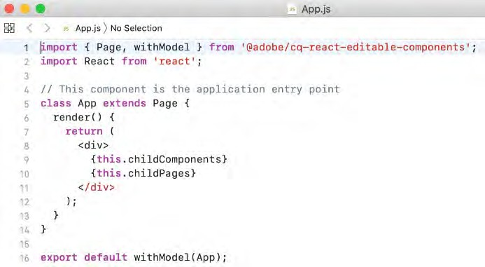
9/30/21
Integrate Experience Manager SPA Editor JS SDK – react-app/src/App.js
App.js extends Page class from
@adobe/cq-react-editable-components
render() function this.childComponents and this.childPages include React components driven by JSON model
88
© 2021 Adobe. All Rights Reserved
88
Adobe Digital Learning Services
9
ComponentMapping
Library provided as an NPM package Stores front-end components
Provides a way for the SPA to map front-end components to AEM resource types:
Enables a dynamic resolution of components when parsing the JSON model of the application
Each item present in the model contains a :type field that exposes an Experience Manager
resource type
Front-end component can render itself using the fragment of model it has received from the underlying libraries
89
© 2021 Adobe. All Rights Reserved
89
Adobe Digital Learning Services

Slide 45
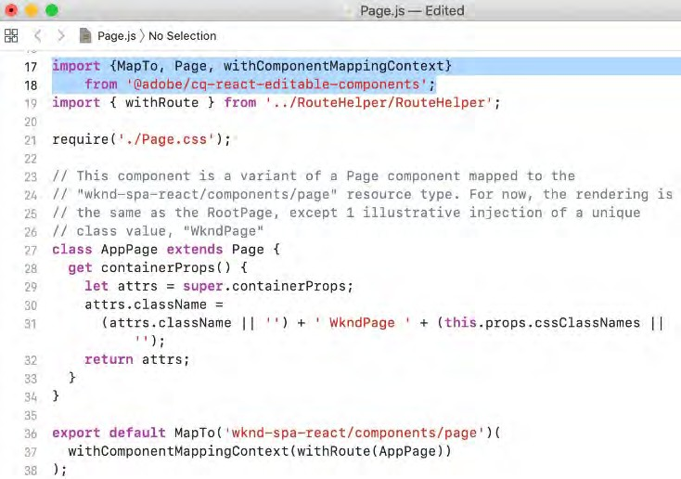
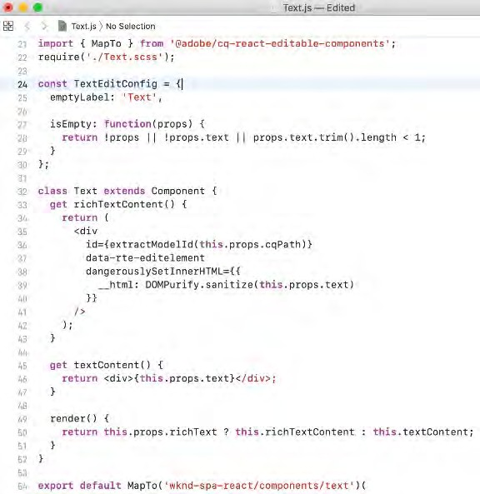
9/30/21
0
Integrate AEM SPA Editor JS SDK – react-app/src/components/page/page.js
Map AEM resource type
wknd-spa-react/components/page
to a React component WKNDPage
90
© 2021 Adobe. All Rights Reserved
90
Adobe Digital Learning Services
1 | Text Component Set up a default editConfig for the Text component AEM properties available as React ‘props’ |  | Map the AEM Text component to a React component that allows rich text authoring as part of the app
 | © 2021 Adobe. All Rights Reserved | 91 | Adobe Digital Learning Services
91

Slide 46

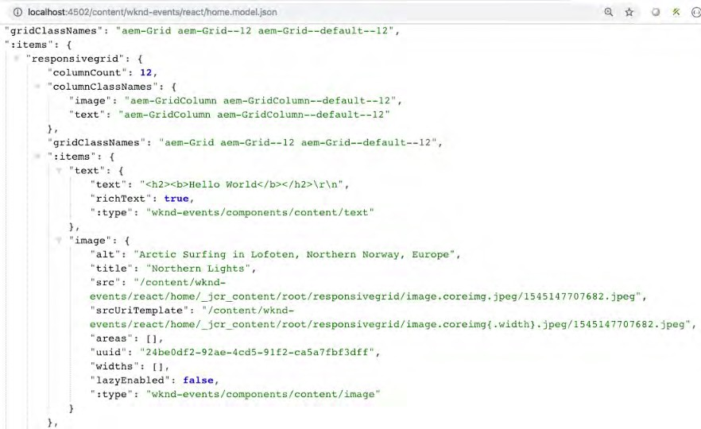
9/30/21
2
Image Component Model JSON Export
MapTo functionality exposes the JSON values of alt, title, src that can then be used by the React Image component.
92
© 2021 Adobe. All Rights Reserved
92
Adobe Digital Learning Services
Key Takeaways
Experience Manager takes a hybrid approach
Delivers content either as fully formatted HTML or as JSON over HTTP APIs
Experience Manager includes features that express content in a variety of formats through API endpoints:
Content services – exposes content via HTTP APIs using a standard JSON schema, enabling brands to expose content to any channel without coding.
Sling Model Exporter – allows developers to quickly render any Experience Manager content into JSON using custom business logic.
93
© 2021 Adobe. All Rights Reserved
93
Adobe Digital Learning Services

Slide 47
9/30/21
Key Takeaways
AEM SPA Editor
Collection of JS libraries
Framework for editing contents of a SPA deployed in Experience Manager
AEM delivers content as JSON and SPA Editor JS SDK maps the JSON to React and Angular components
94
© 2021 Adobe. All Rights Reserved
94
Adobe Digital Learning Services
5
Resources
Experience Manager Headless
https://docs.adobe.com/content/help/en/experience-manager-learn/getting-started-with-aem- headless/overview.html
https://www.adobe.com/content/dam/www/us/en/marketing/experience-manager- sites/headless-content-management-system/pdfs/aem-hybrid-architecture-wp-1-18-19.pdf
https://docs.adobe.com/content/help/en/experience-manager-65/developing/components/json- exporter-components.html
95
© 2021 Adobe. All Rights Reserved
95
Adobe Digital Learning Services

Slide 48
9/30/21
6
Resources (cont)
Experience Manager SPA Editor
https://docs.adobe.com/content/help/en/experience-manager- 65/developing/headless/spas/spa-overview.html
https://docs.adobe.com/content/help/en/experience-manager-learn/sites/spa-editor/spa- editor-framework-feature-video-use.html
Experience Manager SPA Tutorials
https://experienceleague.adobe.com/docs/experience-manager- 65/developing/headless/spas/spa-wknd.html?lang=en
96
© 2021 Adobe. All Rights Reserved
96
Adobe Digital Learning Services
Introduction to AEM as a Cloud Service
97

Slide 49

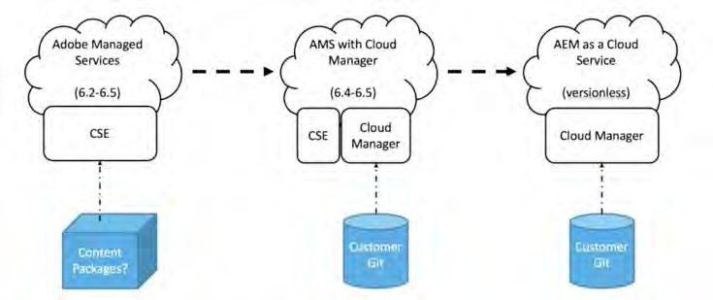
9/30/21
Adobe Experience Manager as a Cloud Service: What is it?
Next generation of the Experience Manager product line evolving into a cloud native solution
Provides Continuous Delivery and Continuous Integration for updates with zero downtime.
Delivers content quickly and efficiently, leveraging a built-in Content Delivery Network (CDN) and other network layer best practices
Is based on a dynamic architecture that autoscales, thus removing infrastructure considerations
Is security focused, using automated tests to scan for common vulnerabilities
Validates customer code using automated tests
Has performance topologies optimized for maximum resilience and efficiency
Is deeply integrated with the Adobe Experience Cloud
98
© 2021 Adobe. All Rights Reserved
98
Adobe Digital Learning Services
Evolution of support for Cloud Deployment
© 2021 Adobe. All Rights Reserved
99
Adobe Digital Learning Services
99
© 2021 Adobe. All Rights Reserved 99 Adobe Digital Learning Services

Slide 50








9/30/21
Adobe Experience Manager Cloud Service: Key Characteristics
1 2
Always On
Always Current
Best in class service level | No content freeze or downtime
Protection against cloud disasters and failures | Robust on-demand data storage
Continuous access to the latest innovations
Automated rolling product updates
3
Always at Scale
4
Always Learning
Ensure performance during peak hours of traffic by visitor and users | Auto-scaling (publish & author)
Faster rendering and processing of 100%- pixel quality assets | Microservices for assets ingestion and processing
Always up-to-date with performance enhancements and security updates | Automated corrective updates
Intelligence and machine learning by default | Native access to Sensei intelligence
© 2021 Adobe. All Rights Reserved
100
Adobe Digital Learning Services
100
© 2021 Adobe. All Rights Reserved 100 Adobe Digital Learning Services
1
Adobe Experience Manager Cloud Service: Runtime Architecture
Per Environment
CDN Service
Shared Service
Containers
Replication Service
Content Repository Service
CI/CD Service
Identity Management Service
Assets Compute Service
Container Orchestration Service
© 2021 Adobe. All Rights Reserved
101
Adobe Digital Learning Services
101
© 2021 Adobe. All Rights Reserved 101 Adobe Digital Learning Services

Slide 51

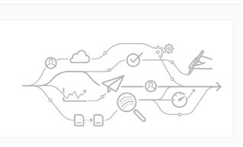






9/30/21
Cloud Manager
Essential component to Adobe Experience Manager Cloud Service
Single entry point for the operations and developer persona
AEM programs and environments managed from Cloud Manager
New tenants of the Adobe Experience Manager Cloud Service provisioned for Cloud Manager access
Controls and manages all updates to the instances of the AEM Cloud Service
Mandatory, and the only way to build, to test and to deploy the customer application both to the Author and the Publish services
102
© 2021 Adobe. All Rights Reserved
102
Adobe Digital Learning Services
Cloud manager entities
Programs | Environments | Pipelines
Program: High-level entity, typically | Environment: composed of an | CI/CD Pipeline: enables AEM
associated with a service level | author tier and a publish tier. Cloud | project teams to quickly, safely and
agreement (contract) that contains | Manager environments typically | consistently deploy code to AEM
production and non-production | have one production environment | environments
environments | and one stage environment. | Cloud manager enables self-service
 |  | creation of CI/CD pipelines that
Cloud manager enables self-service | Cloud manager enables self-service | enforce best practices
creation of AEM applications (AEM | creation of AEM environments
Sites, AEM Assets) within a program | (production and non-production)
© 2021 Adobe. All Rights Reserved | 103 | Adobe Digital Learning Services
103

Slide 52
9/30/21
Adobe Experience Manager Cloud Service: Deployment Architecture
Customer Code Changes
Adobe Release Orchestration
Customer Code CI/CD
Code Building/Testing
Image Building
Non-Production Environments
Baseline AEM Releases
Adobe Release Validation
Stage Deployment
Adobe Code CI/CD
Security Testing
Stage Environment
Regression Testing
Adobe Code Changes
Performance Testing
Several Times a Day
Prod Deployment
Production Environment
© 2021 Adobe. All Rights Reserved
104
Adobe Digital Learning Services
104
© 2021 Adobe. All Rights Reserved 104 Adobe Digital Learning Services
5
AEM as a Cloud Service Key Evolutions – Separation of Content from Code
Architecture completely separates the application content from the application code and configuration
All code and configuration is practically immutable and baked into the baseline image used to create the various nodes of the author and publish services
Absolute guarantee: Each node is identical
Changes to code and configuration can only be made globally by running a Cloud Manager pipeline
105
© 2021 Adobe. All Rights Reserved
105
Adobe Digital Learning Services

Slide 53

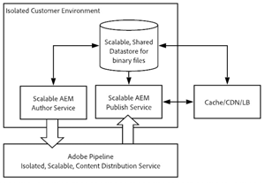
9/30/21
AEM as a Cloud Service Key Evolutions – Binary Content
Files (blobs) are directly uploaded and served from a cloud data store
Associated stream of bits never goes through the JVM of the Author and Publish services
Nodes of AEM author and publish services are smaller in size
Author and publish services more compatible with the expectation of fast autoscaling
results in a faster experience when uploading and downloading images, video, etc.
106
© 2021 Adobe. All Rights Reserved
106
Adobe Digital Learning Services
7
AEM as a Cloud Service Key Evolutions – Publishing Content
Publishing operations now involve a pipeline following a subscription pattern Published content is pushed to various queues in the pipeline
Author tier does not need to be aware of the number of nodes in the publish service
Fast autoscaling of the publish tier
107
© 2021 Adobe. All Rights Reserved
107
Adobe Digital Learning Services

Slide 54
9/30/21
AEM as a Cloud Service Key Evolutions – Publish Service
Concept of a golden master introduced to automate the lifecycle of the publish nodes
Specialized publish node
Never accessed by any end user
Node from which all the nodes of the publish service are created
Maintenance operations such as compaction are performed on the content repository attached to the golden master
Publish nodes are recycled daily and do not require any sort of routine maintenance or downtime
108
© 2021 Adobe. All Rights Reserved
108
Adobe Digital Learning Services
9
Adobe Experience Manager Cloud Service: Runtime Architecture – Publish Tier
Per Environment Shared Service Containers
 | CDN Service
Replication Service
CI/CD Service
Content Repository Service
Identity Management Service
Assets Compute Service
Container Orchestration Service
© 2021 Adobe. All Rights Reserved
109
Adobe Digital Learning Services
109
© 2021 Adobe. All Rights Reserved 109 Adobe Digital Learning Services

Slide 55

9/30/21
0 | Content Delivery Flow – Essentially Unchanged 6 4 _{AEM} Webserver/ _{CDN} _{Publish} Dispatcher 7 5 |  | 2 3 | 1 8
© 2021 Adobe. All Rights Reserved |  | 110 | Adobe Digital Learning Services
110
1
Adobe Experience Manager as a Cloud Service CDN Options
Adobe Managed CDN
Experience Manager's out-of-the-box CDN Point to Adobe Managed CDN
Customer points a CDN to Experience Manager's out-of-the-box CDN
111
© 2021 Adobe. All Rights Reserved
111
Adobe Digital Learning Services

Slide 56
9/30/21
2
CDN Cache Invalidation
In general, HTML content is cached in the CDN for 5 minutes Client libraries are cached indefinitely.
Note: client libraries are served on a unique path that changes if the client libraries change. By default, images are not cached
Prior to accepting live traffic, customers should validate with Adobe customer support that the end-to- end traffic routing is functioning correctly.
112
© 2021 Adobe. All Rights Reserved
112
Adobe Digital Learning Services
Key Takeaways
Adobe Experience Manager Cloud Service is the next generation of the AEM product line evolving into a cloud native solution
Adobe Experience Manager Cloud Service is
Always On
Always Current
Always at Scale
Always Learning
Cloud Manager is an essential component to Adobe Experience Manager Cloud Service and the only entry point for deploying Adobe Experience Manager Cloud Service applications
113
© 2021 Adobe. All Rights Reserved
113
Adobe Digital Learning Services

Slide 57
9/30/21
Resources
AEM Cloud Service Documentation
https://docs.adobe.com/content/help/en/experience-manager-cloud-service/core- concepts/home.html
https://docs.adobe.com/content/help/en/experience-manager-cloud- service/overview/terminology.html
https://docs.adobe.com/content/help/en/experience-manager-cloud-service/overview/what-is- new-and-different.html
https://docs.adobe.com/content/help/en/experience-manager-cloud-service/assets/overview.html
https://docs.adobe.com/content/help/en/experience-manager-learn/cloud-service/overview.html
114
©¹¹2⁴021 Adobe. All Rights Reserved
114
Adobe Digital Learning Services
Experience Manager Projects
115

Slide 58


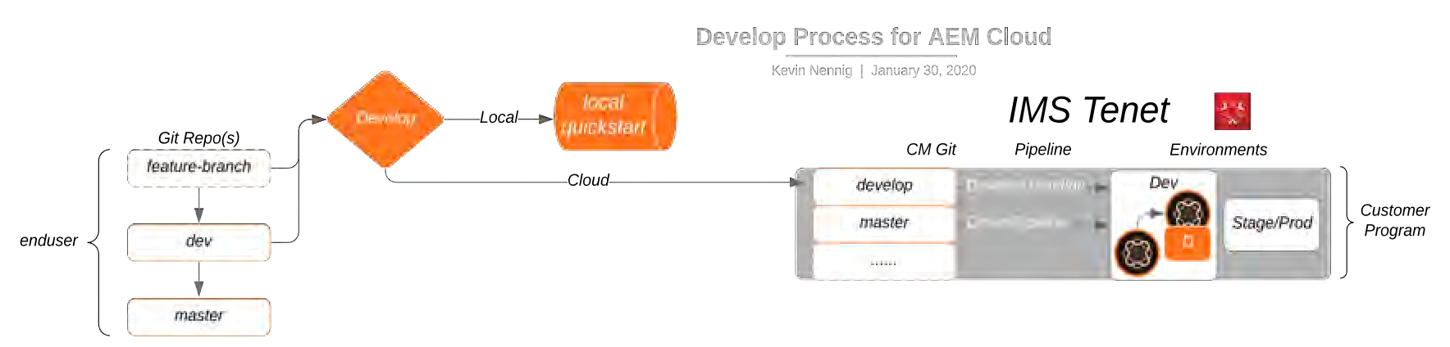
9/30/21
6
Experience Manager Project Code Flow (AMS and AEM Cloud Service)
DevOps persona
Program
Code/Content in Maven Project
Git
AEM Environment Author
Cloud Manager
Git
Publish
<app>
Dispatcher
LB
via browser
<app>
© 2021 Adobe. All Rights Reserved
116
Adobe Digital Learning Services
116
© 2021 Adobe. All Rights Reserved 116 Adobe Digital Learning Services
7
General Process for AMS and Adobe Experience Manager Cloud Service
Code is managed in a customer git repo Normal development occurs
Branches can then be pushed into the CM git for Cloud
Code is tested in non-production before moving to production
Developer persona
IMS Tenant
DevOps persona
117
© 2021 Adobe. All Rights Reserved
117
Adobe Digital Learning Services

Slide 59

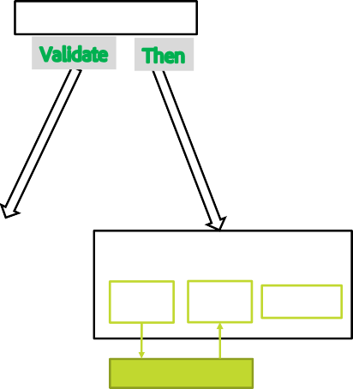

9/30/21
Non-Production
master
develop*
master
develop*
Non-production Pipeline
Customer’s Git (origin)
CM Git (adobe)
Dev Environment
Code Quality only
Author Service
Publish Service
Dispatcher
A develop branch can be setup on CM git that would facilitate non-production activities such as loading into the Dev Environment
Adobe Pipeline
©¹¹2⁸021 Adobe. All Rights Reserved
118
Adobe Digital Learning Services
118
© 2021 Adobe. All Rights Reserved 118 Adobe Digital Learning Services
Production
master*
develop*
master*
develop*
Production Pipeline
Customer’s Git (origin)
CM Git (adobe)
Stage Environment
Prod Environment
Once a release candidate is chosen, code can be merged into Master. Master can be hooked up to a different pipeline for production. Production will pass through Stage and Prod Environments
Author Service
Publish Service
Dispatcher
Author Service
Publish Service
Dispatcher
Adobe Pipeline
Adobe Pipeline
©¹¹2⁹021 Adobe. All Rights Reserved
119
Adobe Digital Learning Services
119
© 2021 Adobe. All Rights Reserved 119 Adobe Digital Learning Services

Slide 60
9/30/21
0
AEM Cloud Service Environments: Local vs Dev vs Stage vs Prod. ***
Capability | Local Dev | Cloud Dev Author | Cloud Dev Pub | Cloud Stage and Prod - Author | Cloud Stage and Prod - Publish
Access to admin user | Yes | No | No | No | No
CRXDE Light | Yes | Yes (limited) | No | No | No
Package Manager UI | Yes | Yes (limited) | No | Yes (limited) | No
SSL Configuration UI | Yes | auto-config | auto-config | auto-config | auto-config
***May differ as AEM Cloud Service evolves
120
© 2021 Adobe. All Rights Reserved
120
Adobe Digital Learning Services
1
AEM Cloud Service Environments: Local vs Dev vs Stage vs Prod (cont) ***
Capability | Local Dev | Cloud Dev Author | Cloud Dev Pub | Cloud Stage and Prod - Author | Cloud Stage and Prod - Publish
Asset Processing on upload and update | DAM Update Workflow | Asset Compute | None | Asset Compute | None
Page Editor/Developer Mode | Yes | No | N/A | No | N/A
Publish Content | Replication agents Classic UI Replication Configuration UI | Sling Content Distribution – auto- configuration | No | Sling Content Distribution – auto- configuration | No
***May differ as AEM Cloud Service evolves
121
© 2021 Adobe. All Rights Reserved
121
Adobe Digital Learning Services

Slide 61
9/30/21
Local Development
122
Local Development - Introduction
Fundamentals of code development for Adobe Experience Manager Cloud Service are similar to prior releases of Experience Manager:
Developers check out code from source control
Developers write code and test it locally
Tested code is checked in to local source control
Cloud Manager
Code pushed to Cloud Manager git repository
Code sent into the pipeline for remote Adobe Experience Manager Cloud environments
Cloud Manager is the sole mechanism for deploying code to Adobe Experience Manager Cloud environments
123
© 2021 Adobe. All Rights Reserved
123
Adobe Digital Learning Services

Slide 62
9/30/21
4
AEM Cloud Service Version Updates vs Deployed Customer Code
Experience Manager version updates and release orchestration are separate deployment events from pushing customer custom code:
Updates that happen after customer code has been deployed are automatically applied
Version updates are intended to be backwards compatible with the customer code already deployed
Custom code releases should be tested against the Experience Manager version that is on production
124
© 2021 Adobe. All Rights Reserved
124
Adobe Digital Learning Services
AEM Cloud Service: Deployment Architecture
Adobe Release Orchestration
Customer Code Changes
Customer Code CI/CD
Baseline AEM Releases
Code Building/Testing
Image Building
Non-Production Environments
Adobe Release Validation
Adobe Code CI/CD
Stage Deployment
Security Testing
Regression Testing
Stage Environment
Adobe Code Changes
Performance Testing
Several Times a Day
Prod Deployment
Production Environment
© 2021 Adobe. All Rights Reserved
125
Adobe Digital Learning Services
125
© 2021 Adobe. All Rights Reserved 125 Adobe Digital Learning Services

Slide 63
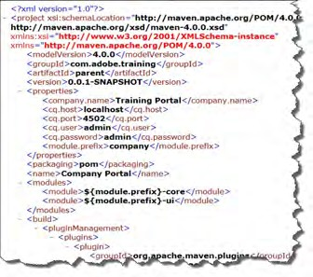
9/30/21
126
Maven
Open source development tool used to build and manage Java-based projects.
It describes how software is built, as well as its dependencies
Has a central repository from which it can dynamically download Java libraries and plug-ins Configured using Project Object Model (POM) files.
Advantages
Build process is easier (after the project is set up properly)
Provides a uniform build system
Provides quality project information
Provides guidelines for development best practices
Allows transparent migration to new features
126
© 2021 Adobe. All Rights Reserved
126
Adobe Digital Learning Services
127
Contents of a POM File
POM files are XML files that contain the identity and structure of the project, build configuration, and other dependencies
A POM file contains:
General project information
Build settings
Build environment
POM relationships and dependencies
Snapshot versions
Property references
Plug-ins
Sample POM file
127
© 2021 Adobe. All Rights Reserved
127
Adobe Digital Learning Services

Slide 64

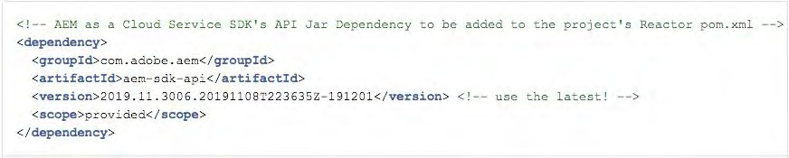

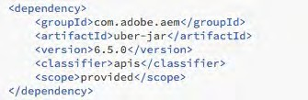
9/30/21
128
API Jar (Uber Jar in AEM 6.5)
API Jar is a special JAR file provided by Adobe
Used to reduce the number of dependencies API Jar file contains:
All public Java APIs exposed by Experience Manager .
Limited external libraries—all public APIs available in Experience Manager that comes from Apache Sling, Apache Jackrabbit, Apache Lucene, Google Guava, and two libraries used for image processing
Interfaces and classes exported by an OSGi bundle in Experience Manager
MANIFEST.MF file with the correct package export versions for all the exported packages
128
© 2021 Adobe. All Rights Reserved
128
Adobe Digital Learning Services
9
API Jar and pom.xml
pom.xml: Define a dependency on the API jar that matches the AEM version
129
© 2021 Adobe. All Rights Reserved
129
Adobe Digital Learning Services

Slide 65

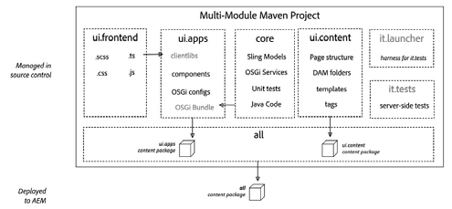
9/30/21
AEM Project Archetype 25
Strongly recommended for any Experience Manager project
Creates a minimal, best-practices-based Adobe Experience Manager project
Built in support for Adobe Experience Manager as a Cloud Service
Built in SPA support
130
©¹³2⁰021 Adobe. All Rights Reserved
130
Adobe Digital Learning Services
AEM Project Archetype Modules all – container package core – java bundle containing core functionality dispatcher – dispatcher configuration ui.apps –/apps and /etc ui.apps.structure – repository roots into which project code deploys ui.config – OSGi configuration definitions ui.content – content using the components from ui.apps |  | ui.tests – java bundle containing Junit tests that are executed server-side ui.launcher - glue code that deploys ui.tests ui.frontend.general – optional artifacts required to use the general Webpack-based front-end build module. Results of build copied into ui.apps as a client library ui.frontend.react - optional artifacts required when creating a SPA project based on React. Results of build copied into ui.apps as a client library ui.frontend.angular – optional artifacts required when creating a SPA project based on Angular. Results of build copied into ui.apps as a client library
© 2021 Adobe. All Rights Reserved | 131 | Adobe Digital Learning Services
131

Slide 66


9/30/21
2 | AEM Maven Project application java code dispatcher configuration OSGi configurations: /apps/osgiconfig application content: /content, /conf | deploy modules as a single artifact integration tests bundles application code: /apps empty package defines the repository roots that code packages in this project deploy client library files and resources Generated from Maven AEM Project Archetype 25
 | © 2021 Adobe. All Rights Reserved | 132 Adobe Digital Learning Services
132
3
Application Deployments
Single package
Package should contain sub-packages for code, configuration and any supporting baseline content
Separation of content and code
Single content package cannot deploy to both mutable and immutable content
Application must separate code and content into discrete packages for deployment into AEM
133
© 2021 Adobe. All Rights Reserved
133
Adobe Digital Learning Services

Slide 67

9/30/21
4
Package Types
Container packages must have PackageType set to container
Example: all package
Code (immutable) packages must set their packageType to application
Example: ui.apps package
Content (mutable) packages must set their packageType to content
Example: ui.content package
134
© 2021 Adobe. All Rights Reserved
134
Adobe Digital Learning Services
Recommended Package Structure
©¹³2⁵021 Adobe. All Rights Reserved
135
Adobe Digital Learning Services
135
© 2021 Adobe. All Rights Reserved 135 Adobe Digital Learning Services

Slide 68




9/30/21
AEM Cloud Service SDK
Download from Experience Cloud distribution site What’s in it?
Cloud-ready Quickstart jar
Dispatcher tools
AEM cloud-ready quickstart jar
Dispatcher tools
136
© 2021 Adobe. All Rights Reserved
136
Adobe Digital Learning Services
Quirks of Local Development for AEMaaCS
Experience Manager cloud-ready Quickstart uses Replication, not Content Distribution
Classic replication capabilities needs to be used with an Author/Publish setup
Publication mechanism is backwards compatible with the Replication Java APIs
Could Service replication problems cannot be tested on a local cloud-ready instance
Dispatcher tools provide mechanisms to test dispatcher configuration
Local test of dispatcher make use of Docker, therefore you cannot test access to an Experience Manager instance through the dispatcher on a virtual image
137
© 2021 Adobe. All Rights Reserved
137
Adobe Digital Learning Services

Slide 69
9/30/21
Deployment using Cloud Manager
154
AMS: Deployment Architecture
Adobe Release Orchestration
Customer Code Changes
Customer Code CI/CD
Baseline AEM Releases
Code Building/Testing
Image Building
Non-Production Environments
Adobe Release Validation
Adobe Code CI/CD
Stage Deployment
Security Testing
Regression Testing
Stage Environment
Adobe Code Changes
Performance Testing
Prod Deployment
Production Environment
© 2021 Adobe. All Rights Reserved
155
Adobe Digital Learning Services
155
© 2021 Adobe. All Rights Reserved 155 Adobe Digital Learning Services

Slide 70
9/30/21
AEM Cloud Service: Deployment Architecture
Adobe Release Orchestration
Customer Code Changes
Customer Code CI/CD
Baseline AEM Releases
Code Building/Testing
Image Building
Non-Production Environments
Adobe Release Validation
Adobe Code CI/CD
Stage Deployment
Security Testing
Regression Testing
Stage Environment
Adobe Code Changes
Performance Testing
Several Times a Day
Prod Deployment
Production Environment
© 2021 Adobe. All Rights Reserved
156
Adobe Digital Learning Services
156
© 2021 Adobe. All Rights Reserved 156 Adobe Digital Learning Services
7
Cloud Manager
Enables organizations to self-manage Experience Manager in the cloud Includes continuous integration (CI) and continuous delivery (CD) framework
Allows IT teams and implementation partners expedite the delivery of customizations or updates without compromising performance or security
157
© 2021 Adobe. All Rights Reserved
157
Adobe Digital Learning Services

Slide 71




9/30/21
8
Programs
Are a set of environments
Support a customer brand, site, or initiative Have one production environment
Can have many nonproduction environments
Usually correspond to a purchased Service Level Agreements (SLA)
158
© 2021 Adobe. All Rights Reserved
158
Adobe Digital Learning Services
9
Programs (Cont.)
A program maintains:
List of environments
CI/CD pipelines
Key Performance Indicators (KPIs) for testing
The provisioning and autoscale settings
159
© 2021 Adobe. All Rights Reserved
159
Adobe Digital Learning Services

Slide 72




9/30/21
0
Environment
A set of virtual computers within a Program An AEM environment is composed of:
An author service
A publish service
A preview service
Three Environments in a Program
160
© 2021 Adobe. All Rights Reserved
160
Adobe Digital Learning Services
1
An Environment and its services
161
© 2021 Adobe. All Rights Reserved
161
Adobe Digital Learning Services

Slide 73


9/30/21
2
CI/CD Pipelines
Help speed up the delivery of custom code or updates
Have automated CI/CD pipeline that leverages Adobe coding best practices Perform thorough code scan to ensure high code quality
Automate unit and performance testing Produce the code performance report
162
© 2021 Adobe. All Rights Reserved
162
Adobe Digital Learning Services
3
CI/CD Pipeline Flow
163
© 2021 Adobe. All Rights Reserved
163
Adobe Digital Learning Services

Slide 74
9/30/21
4
Pipeline Configuration
Consists of:
The code branch from GIT repository
The triggers to start pipeline
The parameters to control production deployment
Performance test parameters
164
© 2021 Adobe. All Rights Reserved
164
Adobe Digital Learning Services
5
Pipeline Triggers
You can start the pipeline:
On GIT Changes - Starts the CI/CD pipeline whenever commits added to git branch
Manually - On-demand from the UI (or API)
Scheduled - This option will be coming soon in an upcoming release
165
© 2021 Adobe. All Rights Reserved
165
Adobe Digital Learning Services

Slide 75
9/30/21
6
Pipeline Gates
Three gates in the pipeline:
Code Quality
Performance Testing (production pipelines only)
Security Testing (production pipelines only)
166
© 2021 Adobe. All Rights Reserved
166
Adobe Digital Learning Services
7
Code Quality Testing
Scans the source code
Has more than 100 Experience Manager-specific and Java code quality rules Is implemented with SonarQube
167
© 2021 Adobe. All Rights Reserved
167
Adobe Digital Learning Services

Slide 76
9/30/21
8
Code Quality Test Categories
Security rating Reliability rating Maintainability rating Unit test coverage Skipped unit tests
Other Issues such as vulnerabilities, bugs, and code smells Duplicated lines
168
© 2021 Adobe. All Rights Reserved
168
Adobe Digital Learning Services
9
Security Testing
Cloud Manager runs Experience Manager security health checks on the stage following deployment and reports status through the UI.
Aggregates the results from all the Experience Manager instances in the environment. If any instance fails a health check, entire environment fails that health check.
169
© 2021 Adobe. All Rights Reserved
169
Adobe Digital Learning Services

Slide 77





9/30/21
0
Performance Testing
Implemented using a 30-minute test
Traffic levels configured as part of pipeline setup
KPI thresholds configured as part of pipeline setup
170
© 2021 Adobe. All Rights Reserved
170
Adobe Digital Learning Services
1
Pipeline Process in Detail
171
© 2021 Adobe. All Rights Reserved
171
Adobe Digital Learning Services

Slide 78




9/30/21
Configuring the Cloud Service Dispatcher
138
9
Deploy Dispatcher Configuration with Code ***
AEM project (from Archetype)
dispatcher module
assembly instructions for dispatcher module
*** Adobe Managed Services and Cloud Service only
139
© 2021 Adobe. All Rights Reserved
139
Adobe Digital Learning Services

Slide 79


9/30/21
0
Adobe Experience Manager Cloud Service Dispatcher Configuration File Structure***
***Experience Manager 6.5 with Adobe Managed Services expects different file names
140
© 2021 Adobe. All Rights Reserved
140
Adobe Digital Learning Services
Testing/Validating the Dispatcher Configuration Locally
141

Slide 80




9/30/21
2
AEM SDK Dispatcher Tools
The AEM SDK Dispatcher tools provide:
Vanilla file structure containing the configuration files to include in a maven project for dispatcher
Tooling for customers to validate a dispatcher configuration locally
Docker image that brings up the dispatcher locally
Docker image run script
validator scripts
Sample dispatcher module
142
© 2021 Adobe. All Rights Reserved
142
Adobe Digital Learning Services
3 | Set up Experience Manager publish instance Start AEM Cloud Service local publish instance Deploy application to publish instance Profiles: –Padobe-public –PautoInstallPackagePublish Test deployment by accessing application on publish instance |  | Remember AEM cloud-ready quickstart jar does not come with sample content
© 2021 Adobe. All Rights Reserved |  | 143 | Adobe Digital Learning Services
143

Slide 81







9/30/21
4
Dispatcher tools - validator Utility – create local dispatcher config files
output (dump) folder
144
© 2021 Adobe. All Rights Reserved
144
Adobe Digital Learning Services
5
Run Dispatcher Configuration Test – start docker image w/ Apache
Execute docker_run.sh to start the docker image with the apache web server and the dispatcher in it.
folder with dispatcher config files
AEM publish instance IP address and port
Apache port
./docker_run.sh out 192.168.0.14:4503 8080
145
© 2021 Adobe. All Rights Reserved
145
Adobe Digital Learning Services

Slide 82


9/30/21
6
Test Dispatcher Configuration
Test access through the apache web server (in the docker image) by using http://localhost:8080/content/wknd/us/en.html
Success!!
146
© 2021 Adobe. All Rights Reserved
146
Adobe Digital Learning Services
Additional Dev Resources
147

Slide 83
9/30/21
8
Core Components
Provides robust and extensible base components for Experience Manager, built on the latest technology and best practices
Open Source
Headless/SPA ready
Extensible
Pre-Configurable
Versatile and easy to use
Production ready
WCAG 2.0 accessible
Easy to style
SEO friendly
Versioned
148
© 2021 Adobe. All Rights Reserved
148
Adobe Digital Learning Services
9 | Available Components Breadcrumb Form Button Carousel Form Container Content Fragment Form Hidden Form Options Form Text Image All Core components are headless compliant! More components come available all the time! | Language Navigation List Navigation Page Quick Search Separator Social Media Sharing Tabs Text Title
 | © 2021 Adobe. All Rights Reserved 149 |  | Adobe Digital Learning Services
149

Slide 84




9/30/21
0
Open Source
Well Documented Continuous improvements Optionally upgrade
150
© 2021 Adobe. All Rights Reserved
150
Adobe Digital Learning Services
51
AEM Component Library
Online showcase of the current version Interact with component variations View the HTML and JSON output
Ships with Experience Manager 6.5 sample content
http://opensource.adobe.com/aem-core-wcm-components/library.html
151
© 2021 Adobe. All Rights Reserved
151
Adobe Digital Learning Services

Slide 85








9/30/21
2
ACS Commons
ACS Commons is:
ACS Commons is not a:
A set of tools created and managed by ACS
An open source on GitHub
A method to bootstrap AEM projects with common functionality
A set of reusable components
An AEM development toolkit
Framework library with required 3rd party dependencies
Library that changes standard AEM functionality
152
© 2021 Adobe. All Rights Reserved
152
Adobe Digital Learning Services
3
Administration Tools in ACS Commons
Common workflow processes
On-Deploy scripts Manage Controlled Process
Manage Controlled Process (MCP) tools
Vanity path rewrite mapper
Health checks
Exporters
Workflow remover
JSON event logger
Audit log search
Dispatcher flush UI
Bulk workflow manager v2
Along with commons, developer tools and code samples are available in ACS.
Packagers (including permissions)
Dispatcher flush rules
153

Slide 86
9/30/21
Migration Tools to assist in moving to Adobe Experience Manager as a Cloud Service
172
Unified Experience
aio-cli-plugin-aem-cloud-service-migration plugin consists of two main parts: User Interface
aio-cli commands to execute one or more code refactoring tools (via chaining the tools to be executed sequentially)
config.yaml which takes in the required input parameters Code Refactoring Tool Suite
Scanning the respective section of customer’s code and manipulating the code (based on code implementation for best practices) to produce the output which can then be validated and deployed.
Producing a summary report to record the operations performed during execution
173
© 2021 Adobe. All Rights Reserved
173
Adobe Digital Learning Services

Slide 87
9/30/21
Repository Modernizer
Experience Manager requires a separation of content and code into discrete sub-packages to respect the split between mutable and immutable content
Utility
restructure existing project packages by separating content and code into discrete packages to be compatible with the project structure defined for Adobe Experience Manager as a Cloud Service
creates a compatible AEM Cloud Service project structure by creating the following deployment structure:
ui.apps package deploys to /apps and contains all the code
ui.content package deployes to runtime-writable areas (e.g. /content, /conf, /home, or anything not /apps) and contains all the content and configuration.
all package is a container package that contains the sub-packages ui.apps and ui.content
174
© 2021 Adobe. All Rights Reserved
174
Adobe Digital Learning Services
Asset Workflow Migration Tool
Migrate existing asset processing workflows from on-prem or Adobe Managed Services deployments of Experience Manager to:
Asset processing profiles
OSGi Configurations
175
© 2021 Adobe. All Rights Reserved
175
Adobe Digital Learning Services

Slide 88
9/30/21
AEM Dispatcher Converter
Convert existing on prem and Adobe Managed Services (AMS) AEM Dispatcher configurations to Experience Manager as a Cloud Service Dispatcher configurations
176
© 2021 Adobe. All Rights Reserved
176
Adobe Digital Learning Services
Index Converter
Migrate existing Custom Oak Index Definitions to Adobe Experience Manager as a Cloud Service compatible Custom Oak Index Definitions
Two ways to create Custom Oak Index Definitions:
under /apps (through any custom content package)
directly under /oak:index path
NOTE: Index Converter only transforms lucene type Custom Oak Index Definitions which are
present under /apps or /oak:index. It does not transform lucene type indexes which are created for nt:base.
177
© 2021 Adobe. All Rights Reserved
177
Adobe Digital Learning Services

Slide 89
9/30/21
Code Migration (from Static Templates to Editable Templates)
178
AEM Modernization Tools Easy conversion of: Static templates to editable templates Design configurations to policies Foundation Components to Core Components Classic UI to Touch-Enabled UI (More later on these tools…) Note: The Modernization Tools are not accessible through the They are uploaded to AEM from a content package |  | aio-cli | interface.
© 2021 Adobe. All Rights Reserved | 179 | Adobe Digital Learning Services
179

Slide 90
9/30/21
0
AEM Modernization Tools - Toolkit to Upgrade Existing Sites
Suite of tools for converting legacy Experience Manager features to the current capabilities. Consists of:
Template Conversion Tool (Static -> Editable)
Policy Conversion Tool (Design Configurations -> Policies)
Component Conversion Tool (Legacy -> Modern/Core)
Dialog Conversion Tool (Classic -> Touch Enabled UI)
180
© 2021 Adobe. All Rights Reserved
180
Adobe Digital Learning Services
81
Conversion Scenario
The Geometrixx Shapes team has decided to upgrade their Static Templates to the new Editable Templates. They want to start with converting the Home Page template over to a new structure.
They've already set up an initial code using the Adobe Maven AEM Archetype. The next steps are to:
Create a template for the Home Page derived from a base template.
Configure the Home Page template for containers, policies, and components.
Covert the existing home page to use the new editable template.
Verify the updated page.
181
© 2021 Adobe. All Rights Reserved
181
Adobe Digital Learning Services

Slide 91




9/30/21
2
Step 1 – Static Template Evaluation – Annotated Template Structure
Components should be identified by the new component types, not the existing components
Identify Structure
components
IdIdeenntitifyfy StrStrucucturturee
cocommppoonneennttss
182
© 2021 Adobe. All Rights Reserved
182
Adobe Digital Learning Services
3
Step 2 – Define the Structure of the Replacement Editable Template
Carousel
Header and Footer
Two Columns
Nested Structure Components
183
© 2021 Adobe. All Rights Reserved
183
Adobe Digital Learning Services

Slide 92


9/30/21
Step 3 – Convert a Page
Page Template/Structure Conversion Tool
Convert from a legacy static template to an editable template in three steps:
Convert Page Structure
Convert all parsys components to responsive grids
Convert all column controls to a new responsive grid structure, each column is its own responsive grid.
184
©¹⁸2⁴021 Adobe. All Rights Reserved
184
Adobe Digital Learning Services
5
Page Conversion Configuration
Original Static template
sling:resourceType for new page-rendering component
New Editable template
Component order in the root layout container/responsive grid
Capture responsive grid names from the eEditable template.
These will become the ppaarrssyyss
replacements.
185
© 2021 Adobe. All Rights Reserved
185
Adobe Digital Learning Services

Slide 93



9/30/21
6
Page Template/Structure Conversion Tool
Convert
Page(s) to be converted
Static template
186
© 2021 Adobe. All Rights Reserved
186
Adobe Digital Learning Services
7 | Page Conversion Result Components are in configured order in the root container parsys replaced by responsive grids |  | cq:template property points to Editable template sling:resourceType for new page-rendering component
© 2021 Adobe. All Rights Reserved |  | 187 | Adobe Digital Learning Services
187

Slide 94




9/30/21
8
Page Before and After Conversion
After
Before
188
© 2021 Adobe. All Rights Reserved
188
Adobe Digital Learning Services
9
Scenario
The Geometrixx Shapes team realized they have a good amount of custom components on their projects, which they need to review every time Experience Manager gets updated.
An evaluation of their components and the Core Components revealed that they could use the latter as replacement for custom code in many situations and guarantee reduced upgrade work in the future.
189
© 2021 Adobe. All Rights Reserved
189
Adobe Digital Learning Services

Slide 95




9/30/21
0 | Review Custom Components geometrixx/components/header → geodemo/comonents/content/header foundation/components/image → geodemo/comonents/content/image geometrixx/components/text → geodemo/comonents/content/text |  | geometrixx/components/lead → geodemo/comonents/content/lead geometrixx/components/title → geodemo/comonents/content/title
© 2021 Adobe. All Rights Reserved |  | 190 | Adobe Digital Learning Services
190
1
Component Rewrite Rules
Component rewrite rules found at /apps/cq/modernize/rules/<app> Each rule has two parts:
Pattern
Replacement
Pattern to replace
Replacement
191
© 2021 Adobe. All Rights Reserved
191
Adobe Digital Learning Services

Slide 96


9/30/21
Scenario
While upgrading their Static Templates to the new AEM Editable Templates, the Geometrixx Shapes team knew that it would be necessary to replace design elements with policy configurations. That work can be automated:
Evaluate the former design
Import design configurations as policies
Apply policies on editable templates
192
© 2021 Adobe. All Rights Reserved
192
Adobe Digital Learning Services
Geometrixx Design - /etc/designs/geometrixx
Design for each page type
Assets that support the design
Stylesheet that supports Foundation components
Site-wide client library
© 2021 Adobe. All Rights Reserved
193
Adobe Digital Learning Services 193
193

Slide 97






9/30/21
Migrating the Component Policies Older Designs are referenced by the page/container/component path Not reusable across page and container types Design elements for this component on this page type |  | Page/container/component contentpage/par/text | →
©¹⁹2⁴021 Adobe. All Rights Reserved | 194 | Adobe Digital Learning Services
194
5
Design Conversion Rules
195
© 2021 Adobe. All Rights Reserved
195
Adobe Digital Learning Services

Slide 98


9/30/21
New Policies After Conversion
Newer Policies are referenced by sling:resourceType property
Independent policies that can be used in any layout container on any page type
Policy configurations for geodemo application
Record of the conversion
Record of the
conversion
Default size
Resource type associated with the policy
196
©¹⁹2⁶021 Adobe. All Rights Reserved
196
Adobe Digital Learning Services
AEM Project Group Exercise
We will be looking at 3 case studies. For each case study you should design the path to Adobe Experience Manager Cloud Service You have 45 minutes to work on your case study, then we will discuss each case study solution as a group.
© 2021 Adobe. All Rights Reserved 197 Adobe Digital Learning Services
197

Slide 99
9/30/21
Key Takeaways
General Cloud Service Deployment Process
Code is managed in a customer git repo
Normal development occurs
Branches can then be pushed into the Cloud Manager git for Cloud
Code is tested in non-production before moving to production
Use the Cloud Service SDK
Local Development environment is not exactly the same
New Dispatcher project module
198
© 2021 Adobe. All Rights Reserved
198
Adobe Digital Learning Services
Key Takeaways
Cloud Manager is single, essential entry point
Cloud Manager Pipeline Gates
Code Quality
Performance Testing
Security Testing
199
© 2021 Adobe. All Rights Reserved
199
Adobe Digital Learning Services

Slide 100
9/30/21
resources
Cloud Manager
https://docs.adobe.com/content/help/en/experience-manager-learn/foundation/cloud-manager/understand- cloud-manager-for-aem.html
Implementing Applications for AEM Cloud Service
https://docs.adobe.com/content/help/en/experience-manager-cloud-service/implementing/home.html
Cloud Service SDK
https://docs.adobe.com/content/help/en/experience-manager-cloud-service/implementing/developing/aem-as- a-cloud-service-sdk.html
Structure of an AEM project
https://docs.adobe.com/content/help/en/experience-manager-cloud-service/implementing/developing/aem- project-content-package-structure.html
200
©²⁰2⁰021 Adobe. All Rights Reserved
200
Adobe Digital Learning Services
Security
201

Slide 101
9/30/21
Common web application attack techniques
Cross-site scripting (XSS)
Causing a website to execute malicious script code that has been previously uploaded by an attacker
SQL injection (SQLi)
A user enters malicious SQL statements into a field on a web page Path traversal
Access unauthorized files or directories outside the web root folder by injecting patterns, such as “../”
Local file inclusion (LFI)
Use path traversal to or similar mechanism to cause the web application to execute a fiile residing elsewhere on the server
Distributed denial of service
Bombard a targeted web server with requests
202
©²⁰2²021 Adobe. All Rights Reserved
202
Adobe Digital Learning Services
Basic website security concepts
The following basic rules should always be applied to secure a website:
Make available as little information about your system as required
Emphasize access restriction and correct access implementation
Filter out invalid requests as early as possible, e.g, on firewall, web server or, dispatcher
Do not trust any information coming from the user or from an author to be safe
- This includes making sure to protect against XSS and CSRF attacks
203
© 2021 Adobe. All Rights Reserved
203
Adobe Digital Learning Services

Slide 102
9/30/21
Every security issue matters
Even minor flaws should be fixed because:
attacking a website often needs more than one loophole.
even a combination of small loopholes can lead to severe security issues.
204
© 2021 Adobe. All Rights Reserved
204
Adobe Digital Learning Services
Protection against attack
Vulnerability scanning and security testing
Scanning and testing content repositories, networks and applications throughout the development lifecycle can identify where the vulnerabilities are, how dangerous they are and how to mitigate them
Web application firewalls (WAFs)
An important line of defense for critical applications and data, the WAF controls access to web applications using rules
Training
Proper training provides your developers, testers, project managers and architects with information about the latest components of secure software development
205
©²⁰2⁵021 Adobe. All Rights Reserved
205
Adobe Digital Learning Services

Slide 103


9/30/21
User Administration and Security
Authentication
Process of identifying and verifying a user
Proving who you are
Access Control
Restriction of access to a resource
Typically stored in list(s) of permissions granted or denied
Example: A page is read-only to users in a specific user group
Authorization
Determining whether a user is allowed to take action on specific areas within the system
Comparing an identity against a list of permissions
Example: Users in the authors group cannot create new templates
206
© 2021 Adobe. All Rights Reserved
220066
Adobe Digital Learning Services
Actions and Permissions Best Practices
JCR Actions define the right that can be assigned to a group
JCR Permissions allow or deny a user to perform an action on a resource
For each action and on each resource in the repository, a user can have either permission state Allow or Deny.
Experience Manager permissions are granted through the various permissioning consoles:
Configuration Browser
Page Properties permissions tab
Asset Folder Properties permissions tab
AEM Permissions console (Tools > Security > Permissions)
207
© 2021 Adobe. All Rights Reserved
207
Adobe Digital Learning Services

Slide 104
9/30/21
Actions and Permissions Best Practices (cont)
Experience Manager includes out-of-the-box users Before going into production:
Delete all sample/unused users (e.g., application sample/test users)
Change the password for ALL out-of-the-box users
208
© 2021 Adobe. All Rights Reserved
208
Adobe Digital Learning Services
ACL (Access Control Lists) Best Practices
Use groups to assign permissions rather than users
You have many more users than groups, so groups simplify the structure.
Groups help provide an overview over all accounts.
Inheritance is simpler with groups.
Users come and go. Groups are long-term.
Always use Allow statements to specify the access rights of the group principal (wherever possible). Avoid using a Deny statement.
Keep it simple
209
© 2021 Adobe. All Rights Reserved
209
Adobe Digital Learning Services

Slide 105

9/30/21
ACL (Access Control Lists) Best Practices
We have seen that ACLs are based on content hierarchy and child nodes inherit permissions.
As a consequence, security and access requirements should be a main driver when designing the content structure:
Managing access should be easy
Enforcing access control should come for free
Avoid copying content to containers such as /var/* for temporary operations or backup purposes. Verify a proper permission setup.
210
© 2021 Adobe. All Rights Reserved
210
Adobe Digital Learning Services
Example Group Hierarchies
Everyone
Contributors
Contributors
Content Authors
groupX
Content Authors
Application Admin
groupX
211
©²2¹¹021 Adobe. All Rights Reserved
211
Adobe Digital Learning Services

Slide 106
9/30/21
Security - Dispatcher
212
Security Considerations - Dispatcher Configuration
For websites that do not require end user login, disable all means of getting an authenticated session. The following two rules can be implemented:
/1010 { /type "deny" /glob "* *sling:authRequestLogin*"}
/1011 { /type "deny" /glob "* *j_security_check*"}
In addition, HTTP headers authorization and proxy-authorization should not be included in the /clientheaders section (clientheaders.any)
213
©²¹2³021 Adobe. All Rights Reserved
213
Adobe Digital Learning Services

Slide 107
9/30/21
Security Considerations - Dispatcher Filtering
Configure the dispatcher to reject invalid and incorrect requests wherever possible. Requests that are served should be configured from a whitelist:
Only content from valid resource trees and with valid extensions is served.
Both a security measure and a performance optimization method as the load on the Experience Manager instances is reduced
214
© 2021 Adobe. All Rights Reserved
214
Adobe Digital Learning Services
Code Security
215

Slide 108






9/30/21
Code Security
Using Service-based Authentication for ResourceResolver and Repository session solves problems like:
Prevent over-use and abuse of administrative ResourceResolvers and/or JCR Sessions
Allow services access to ResourceResolvers and/or JCR Sessions without requiring hard-coded or configured passwords
Allow services to use service users that have been specially configured for service level access (as is usually done on Unix systems)
Allow administrators to configure the assignment of service users to services
216
© 2021 Adobe. All Rights Reserved
216
Adobe Digital Learning Services
Service User Mapping Example
21
7
217
© 2021 Adobe. All Rights Reserved
217
Adobe Digital Learning Services

Slide 109
9/30/21
Service User
ResourceResolver “borrows” JCR access permissions Permissions provided by an existing JCR user
User is of type ”rep:ServiceUser”
Service User
ResourceResolver
User Mapping Service
JCR
218
©²¹2⁸021 Adobe. All Rights Reserved
218
Adobe Digital Learning Services
Adobe IO
219

Slide 110



9/30/21
Adobe I/O
Highlights:
API endpoint for Adobe Experience Platform
One stop shop for developers
Access to Adobe Sensei
Replaced the Marketing Cloud developer connection
Used to securely connect to Adobe’s products to Experience Manager
220
© 2021 Adobe. All Rights Reserved
220
Adobe Digital Learning Services
Typical Setup of an I/O Integration
Example:
Adobe Identity Management System (IMS) Service Account
Tools > Security > Adobe IMS Configurations
Create a new public certificate
Log in to Adobe I/O and select the integration
Add the public certificate from Experience Manager Add the private key from Adobe I/O to the IMS config
221
© 2021 Adobe. All Rights Reserved
221
Adobe Digital Learning Services

Slide 111


9/30/21
Adobe I/O Supported Services
*
*
*
* through Adobe Launch
222
© 2021 Adobe. All Rights Reserved
222
Adobe Digital Learning Services
Authentication and Authentication Handlers
223

Slide 112

9/30/21
Lightweight Directory Access Protocol
LDAP
Used for accessing centralized directory services
Helps to reduce the effort required to manage user accounts access by multiple applications
LDAP is often used for SSO
User accounts can be synchronized between the LDAP server and repository
This allows accounts to be assigned to repository groups
The repository uses LDAP authentication to authenticate users with credentials being passed to the LDAP server for validation, required for repository access
Successfully validated credentials can be cached by the repository, which improves performance
LDAP server validation is no longer granted when an account is removed
224
© 2021 Adobe. All Rights Reserved
224
Adobe Digital Learning Services
Oak External Authentication
Three main modules
External Login Module
Sync Handler
Identity Provider (IDP)
225
© 2021 Adobe. All Rights Reserved
222255
Adobe Digital Learning Services

Slide 113


9/30/21
Setting up SAML Authentication
Defer authentication to a centralized server
OSGi Runtime environment
HTTP
HTTP
listener
SSO Auth Handler
Servlet Engine (Jetty)
JCR
Remembers your current session
Identity Provider (IDP)
226
© 2021 Adobe. All Rights Reserved
222266
Adobe Digital Learning Services
Adobe Identity Management System (IMS)
Adobe IDs used for accessing the Author tier:
Adobe Admin Console for managing users and user groups within the product contexts
Administrators are responsible for creating, or importing, the end users accounts in
the Admin Console
227
©²²2⁷021 Adobe. All Rights Reserved
227
Adobe Digital Learning Services

Slide 114


9/30/21
Roles Within Adobe IMS
System Admin:
Receives an invite to log in to the Admin console
Claims Domain to confirm the ownership
Sets up User Directories
Product Admin assigns Experience Cloud products to users/groups
Experience Manager Admin manages the local groups, permissions, and privileges
are synchronized with the Admin Console
228
© 2021 Adobe. All Rights Reserved
228
Adobe Digital Learning Services
IMS Authentication
Three types of identities or accounts to authenticate and authorize users:
Federated ID
Enterprise ID
Adobe ID
Enterprise and Federated ID models are an ideal choice for enterprises Adobe ID is best suited for individuals
229
© 2021 Adobe. All Rights Reserved
229
Adobe Digital Learning Services

Slide 115

9/30/21
IMS Authenticaton (Cont.)
An authentication service for all Adobe products
Tightly integrated with all Adobe products
In addition, AEM customers can use IMS service accounts for:
Smart Tags
Adobe Launch
Adobe Stock
Adobe Experience Manager Cloud Service customers can:
Manage users in the Experience Cloud Admin Console
Log in to AEM with IMS credentials
Have Enterprise or Federated accounts
230
© 2021 Adobe. All Rights Reserved
223300
Adobe Digital Learning Services
IMS Architecture
231
© 2021 Adobe. All Rights Reserved
231
Adobe Digital Learning Services

Slide 116



9/30/21
2
User Sync Tool (UST) – Create/Manage users with Active Directory
232
© 2021 Adobe. All Rights Reserved
232
Adobe Digital Learning Services
Connect IMS to Experience Manager for Authentication
Customer onboarding to the Admin console is a prerequisite Must have an IMS organization provisioned by Adobe
Joint effort between AMS and customers Support for local and IMS authentication
233
© 2021 Adobe. All Rights Reserved
233
Adobe Digital Learning Services

Slide 117
9/30/21
Key Takeaways
Basic rules to secure a website:
Make available as little information about your system as required
Emphasize access restriction and correct access implementation
Filter out invalid requests as early as possible, e.g, on firewall, web server or, dispatcher
Do not trust any information coming from the user or from an author to be safe
Use service-based authentication for servlets
Generalized use of Adobe IDs for accessing the AEM Cloud Service
234
© 2021 Adobe. All Rights Reserved
234
Adobe Digital Learning Services
Resources
Whitepaper
https://www.adobe.com/content/dam/acom/en/security/pdfs/adobe-aem-managed-services- security.pdf
IMS support for AEM Cloud Service
https://docs.adobe.com/content/help/en/experience-manager-cloud-service/security/ims- support.html
235
©²³2⁵021 Adobe. All Rights Reserved
235
Adobe Digital Learning Services

Slide 118
9/30/21
JCR Model, Queries and Indexes
© 2021 Adobe. All Rights Reserved
236
© 2021 Adobe. All Rights Reserved 236 Adobe Digital Learning Services
Explaining the JCR Model
A JCR repository:
Is hierarchical
Is flexible
Uses a standard Java API
Abstracts where the information is really stored
Supports queries and full-text search
237
©²³2⁷021 Adobe. All Rights Reserved
237
Adobe Digital Learning Services

Slide 119
9/30/21
JCR Model: Nodes and Properties
The JCR Model is a tree of nodes and properties
Nodes are addressed as a path that, similar to file system paths
Used to organize the content in hierarchical form
Nodes provide the structure Properties store the actual data
simple types (such as string, Boolean, etc.)
binary streams for storing files of arbitrary size
238
©²³2⁸021 Adobe. All Rights Reserved
238
Adobe Digital Learning Services
JCR Content Services
Query (XPath, SQL, JQL) Export/import (XML) Referential integrity Authentication
Access control
Versioning Observation
Locking and transactions (JTA)
239
©²³2⁹021 Adobe. All Rights Reserved
239
Adobe Digital Learning Services

Slide 120

9/30/21
Query execution in Apache Jackrabbit Oak
240
© 2021 Adobe. All Rights Reserved
240
Adobe Digital Learning Services
41
Slow Query Classifications
There are 3 main classifications of slow queries in Experience Manager , listed by severity:
Index-less queries
Queries that do not resolve to an index and traverse the JCR’s contents to collect results
Poorly restricted (or scoped) queries
Queries that resolve to an index, but must traverse all index entries to collect results
Large result set queries
Queries that return very large numbers of results
241
© 2021 Adobe. All Rights Reserved
241
Adobe Digital Learning Services

Slide 121
9/30/21
42
Query Performance Analysis and Optimization
Efficient:
Simple comparison: sling:resourceType = ‘my/type’ Node type match: //element(*, nt:hierarchyNode) Simple fulltext search: jcr:contains(@jcr:title, ‘crx’)
Like on few distinct values: jcr:like(@jcr:mimeType, ‘%/plain’)
242
© 2021 Adobe. All Rights Reserved
242
Adobe Digital Learning Services
3
Query Performance Analysis and Optimization (cont)
Less efficient:
Path constraints: content/geometrixx/en//*[ ... ]
Alternative: turn path into property constraint. E.g, keep language property on every page and write: //*[@language = ‘en’]
Relative path in predicate: //element(*, cq:Page)[jcr:contains(jcr:content, ‘crx’)]
Alternative: shorten path in predicate and post process result:
//element(*, cq:PageContent)[jcr:contains(., ‘crx’)]
243
© 2021 Adobe. All Rights Reserved
243
Adobe Digital Learning Services

Slide 122
9/30/21
4 | Query Performance Analysis and Optimization (cont) Not efficient : jcr:contains w/ initial wildcard: jcr:contains(., ‘*rabbit’) Alternative: don’t do it, unless you know exactly what you are doing! jcr:like on many distinct values:jcr:like(@email, ‘%@gmail.com’) Alternative: store data you want to query in separate property, then you can write: @email-host = ‘gmail.com’ Ranges matching many distinct values: @jcr:lastModified > xs:dateTime(‘2001-09-17T18:17:13.000+02:00') Alternative: reduce resolution (e.g, only store date and not time)
 | © 2021 Adobe. All Rights Reserved 244 | Adobe Digital Learning Services
244
5
Query Performance Analysis and Optimization (cont)
Query result does lazy loading of nodes
Query.execute() may return quickly even if result size is big Reading a large result set completely is always slow
Time to get result: query execution time + node retrieval time
245
© 2021 Adobe. All Rights Reserved
245
Adobe Digital Learning Services

Slide 123
9/30/21
Key Takeaways
Oak does not index content by default
Query engine uses a cost-based query and selects the index with the lowest cost Only create indexes if there are a large number of unique values
Lucene indexes
Offer many more features than property indexes
Asynchronous
Cannot enforce uniqueness constraints
QueryBuilder is a service for building queries searching the JCR and which are easily extensible.
246
© 2021 Adobe. All Rights Reserved
246
Adobe Digital Learning Services
Key Takeaways
AEM Cloud Service Index Management
Create Index on deployment before application requires it
Index Management With Blue-Green Deployment
No downtime.
Requires that indexes only be used by certain versions of the application.
247
© 2021 Adobe. All Rights Reserved
247
Adobe Digital Learning Services

Slide 124
9/30/21
8
Resources
Content Search and Indexing
https://docs.adobe.com/content/help/en/experience-manager-cloud- service/operations/indexing.html
248
© 2021 Adobe. All Rights Reserved
248
Adobe Digital Learning Services
Performance
© 2021 Adobe. All Rights Reserved
249
© 2021 Adobe. All Rights Reserved 249 Adobe Digital Learning Services

Slide 125
9/30/21
Poor Performance
The following factors negatively impact performance in Experience Manager:
Improper design
Application code with bad practices
Poor network bandwidth and latency
250
© 2021 Adobe. All Rights Reserved
250
Adobe Digital Learning Services
5
Optimization to Avoid Performance Issues
Find and fix performance issues before they have an impact on your users:
Oak Query Engine / Index optimizations
Cacheability
CRX Performance
Lucene Index performance
251
© 2021 Adobe. All Rights Reserved
251
Adobe Digital Learning Services

Slide 126














9/30/21
5
Basic Process: The Application is SLOW!
Perceived Problem
Challenge and Understand Reproduce and Measure
Analyze and Fix
Confirm Solution or Repeat
252
© 2021 Adobe. All Rights Reserved
252
Adobe Digital Learning Services
Experience Manager Architecture Customer Application Experience Manager Apache Sling Apache Oak Jetty Apache Felix JVM Operating System |  | What we call ‘Experience Manager ’ is really a complex multi-layered application Each layer has separate responsibilities and characteristics Generally things don’t go wrong without some triggering event Failures in any layer often manifest as visible issues in the layers above Excessive demand from above can cause issues in lower levels We need to track back from symptoms to identify root-cause
© 2021 Adobe. All Rights Reserved | 253 | Adobe Digital Learning Services
253

Slide 127


9/30/21
4 Experience Manager Architecture - Symptoms and Causes
Customer Application
Customer Application
Symptom: Components failing to render / exceptions in the log
Cause: Bad / unexpected data
Cause: Bugs in customer application
Cause: Bundles and services not starting
Symptom: Slow page rendering times
Cause: Bottlenecks in lower tiers (Sling Models, Oak)
Cause: Slow external/backend calls
Cause: Excessive JVM GC
Experience Manager
Apache Sling
Apache Oak
Jetty
Apache Felix
JVM
Operating System
254
© 2021 Adobe. All Rights Reserved
254
Adobe Digital Learning Services
5
5
Experience Manager Architecture – Symptoms and Causes
Adobe Experience Manager
Customer Application
Web Content and Asset Management
Platform
Symptom: Unexpected behavior in Authoring UI
Experience Manager
Apache Sling
Cause: Overlays out-of-date (due to hotfix, service pack or feature pack)
Cause: Bad / unexpected data
Symptom: Workflows failing to appear in console
Cause: Async indexer failing
Symptom: Slow to start up
Cause: Long Sling job queues
Apache Oak
Jetty
Apache Felix
JVM
Operating System
255
© 2021 Adobe. All Rights Reserved
255
Adobe Digital Learning Services

Slide 128


9/30/21
Experience Manager Architecture – Symptoms and Causes
Customer Application
Apache Sling
RESTful API on repository
Routes requests to scripts (code)
Symptom: Updated artifacts not being picked up from repository
Cause: Sling OSGI / JCR installer failing
Experience Manager
Apache Sling
Apache Oak
Jetty
Apache Felix
JVM
Operating System
256
© 2021 Adobe. All Rights Reserved
256
Adobe Digital Learning Services
5
Experience Manager Architecture – Symptoms and Causes
Apache Oak
Customer Application
No-SQL persistence layer supporting multiple backends (Tar files, Mongo, RDBMS)
Implementation of Java Content Repository standard
Symptom: Async indexes failing
Cause: Missing binaries in Datastore
Cause: Index corrupt on disk
Symptom: Slow query processing
Cause: Missing index or incorrect index selection
Symptom: Rapid repository file growth
Cause: looping workflows
Experience Manager
Apache Sling
Apache Oak
Jetty
Apache Felix
JVM
Operating System
257
© 2021 Adobe. All Rights Reserved
257
Adobe Digital Learning Services

Slide 129


9/30/21
8 Experience Manager Architecture – Symptoms and Causes
Customer Application
Apache Jetty
Experience Manager
Web Container (providing servlets / jsp support)
Receives incoming requests and routes passes to Sling for processing
Symptom: Server not accepting requests
Cause: Thread limit reached due to slow processing of previous requests
Apache Sling
Apache Oak
Jetty
Apache Felix
JVM
Operating System
258
© 2021 Adobe. All Rights Reserved
258
Adobe Digital Learning Services
Experience Manager Architecture Customer Application Experience Manager Apache Sling Apache Oak Jetty Apache Felix JVM Operating System |  | Apache Felix Implementation of OSGI (Module and service framework for Java) Symptom: Artifacts not installing Cause: Sling OSGI / JCR installer blocked or failing Symptom: Unable to authenticate / admin password changed Cause: Repository failing to start
© 2021 Adobe. All Rights Reserved | 259 | Adobe Digital Learning Services
259

Slide 130


9/30/21
Experience Manager Architecture – Symptoms and Causes
Customer Application
Java Virtual Machine
Experience Manager
Apache Sling
Symptom: Excessive garbage collection
Cause: Memory leak
Cause: Large or inefficient query result set
Apache Oak
Jetty
Apache Felix
JVM
Operating System
260
© 2021 Adobe. All Rights Reserved
260
Adobe Digital Learning Services
Experience Manager Architecture – Symptoms and Causes
Customer Application
Operating System (RHEL – Red Hat Enterprise Linux)
Experience Manager
Symptom: Large IO Wait
Cause: TarMK memory mapping inefficient
Symptom: Too many open files
Cause: Repeated failed async index cycles
Symptom: Excessive memory consumption
Cause: JVM heap too large
Cause: Consumption by ’native’ components (ImageMagick, FFMPEG, XMP, CameraRAW, Flite etc)
Apache Sling
Apache Oak
Jetty
Apache Felix
JVM
Operating System
261
© 2021 Adobe. All Rights Reserved
261
Adobe Digital Learning Services

Slide 131
9/30/21
Identifying the Problem Area
Unless you have seen the exact scenario before, the first step will be to identify the overall problem
area
AEM provides a number of tools which can provide hints that things are not working as they ought to
be
By checking each of these, you can identify any unexpected results which might require deeper
investigation
Request Log ▪ Request Performance tool
_{Access Log} ▪ Chrome Plugin ▪ Query Performance tool
_{Error Log} ▪ NewRelic ▪ JMX Beans
_{Custom Logs} ▪ Operating System tools like Top ^{▪ Profiler}
© 2021 Adobe. All Rights Reserved | 262 | Adobe Digital Learning Services
262
Digging Deeper
After identifying the problem area, it’s time to dig deeper to try to understand the root cause. Different set of tools and skills
Sometimes the issue is obvious on deeper inspection Sometimes it’s necessary to formulate a theory
Use deeper investigation to prove or disprove it
Thread Dumps and Heap Dumps
pmap
Open source product Jira and Git
Application Source
263
© 2021 Adobe. All Rights Reserved
263
Adobe Digital Learning Services

Slide 132
9/30/21
4
Tooling
Available system monitoring data
Tools on OS level (perfmon, iostat, top, netstat, tcpdump, …) Leverage threaddumps (either via kill–QUIT or via Felix Console)
Garbage collection logs of the JVM request.log
End-to-End monitoring / end-to-end benchmarks jVisualVM
264
© 2021 Adobe. All Rights Reserved
264
Adobe Digital Learning Services
Key Takeaways
What we call ‘Experience Manager ’ is really a complex multi-layered application
Each layer has separate responsibilities and characteristics
Generally things don’t go wrong without some triggering event
Failures in any layer often manifest as visible issues in the layers above
Excessive demand from above can cause issues in lower levels
We need to track back from symptoms to identify root-cause
265
© 2021 Adobe. All Rights Reserved
265
Adobe Digital Learning Services

Slide 133
9/30/21
Solution Design
© 2021 Adobe. All Rights Reserved
266
© 2021 Adobe. All Rights Reserved 266 Adobe Digital Learning Services
Solution Design: Background
Designing solutions is a large part of the Architect role
Solution designs must be detailed enough for hand-off to the customer or partner for implementation The Architect must ask the “glass ball” questions and not be short-sighted in the design
The customer has requirements, but may not understand the possible technical impacts of their choices
Document assumptions in the design:
Amount of data
Data change rates
Implementation requirements and performance risks
Infrastructure requirements
Business process (workflow) impacts
267
©²⁶2⁷021 Adobe. All Rights Reserved
267
Adobe Digital Learning Services

Slide 134

9/30/21
Final Solution Design Exercise
Each group will get a different assignment Produce some real-world solution designs Each group will present their task, solution, and answer questions Make the solutions detailed and implementation-ready Instructor represents the customer
© 2021 Adobe. All Rights Reserved 268 Adobe Digital Learning Services
268
269

